Slide 1
6.1 The Catholic Monarchs
Spain in the 15th and 16th Centuries

Slide 2
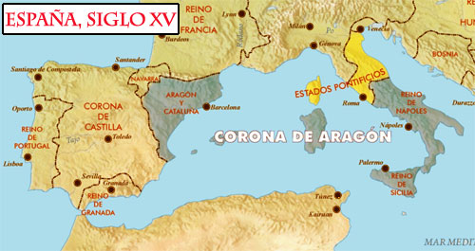
Context: Spain in the 15th Century
Beginning of the Modern Age
Changes in the international panorama (disappearance of the Byzantine Empire, geographical discoveries, struggle for European hegemony).
The feudal system entered a period of crisis (birth of authoritarian monarchies)
Beginning of Humanism and the Renaissance
The Catholic Monarchs

Slide 3
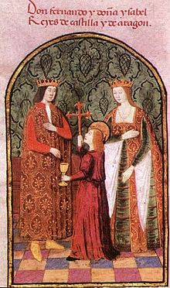
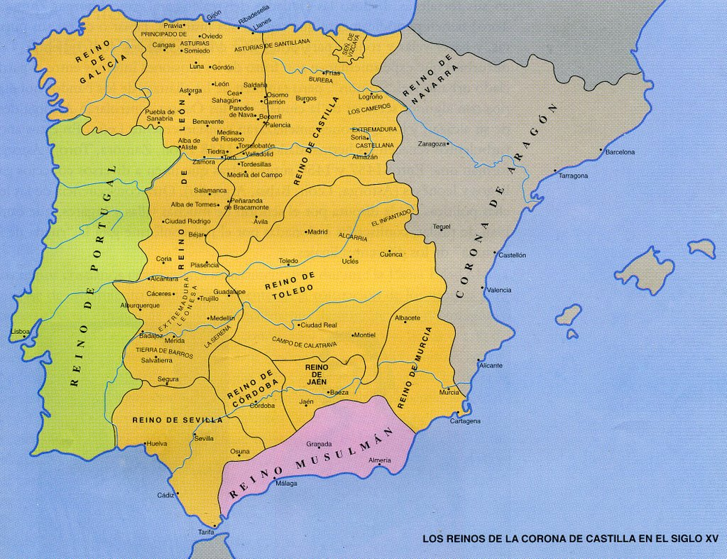
The Dynastic Union of Castilla and Aragón
Isabella I of Castile (1451-1504) and Ferdinand II of Aragon (1452-1516)
Married in 1469 and began to unify the kingdom of Castile and the Crown of Aragon’s states.
Complete unification in 1479 (birth of a Modern state)
Only Dynastic Union - other than the Catholic Monarchs’ rule, nothing else in common (different institutions, laws, customs and currencies).

Slide 4
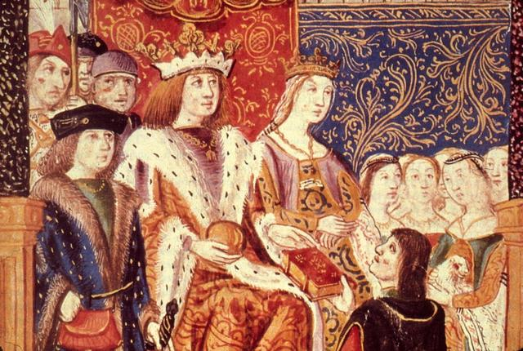
The Strengthening of the State
The Catholic Monarchs established an authoritarian monarchy and they controlled all powers of the State. Three main ways:
Territorial Unification
Religious Unity
Establishment of the Modern State

Slide 5
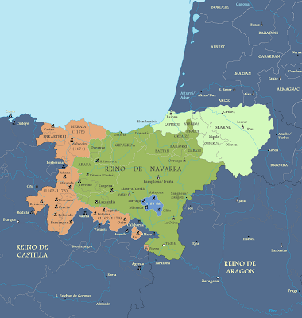
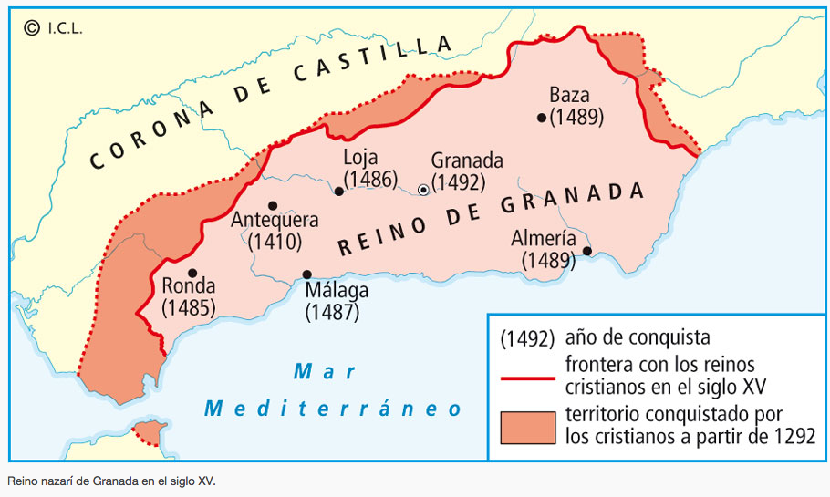
Territorial Unification
Annexation of the Nasrid Kingdom of Granada (1492) by Castilla.
Annexation of the Kingdom of Navarre (1512) by Aragon.
Completed the (re)conquest of the Iberian Peninsula. Also prepared efforts for future unions with Portugal through marriage alliances.

Slide 6
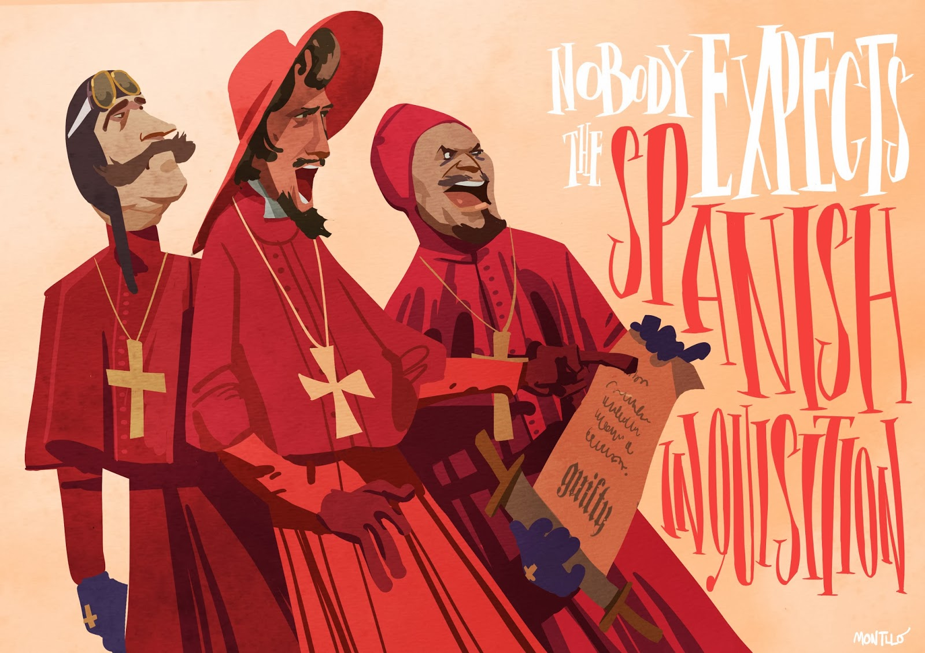
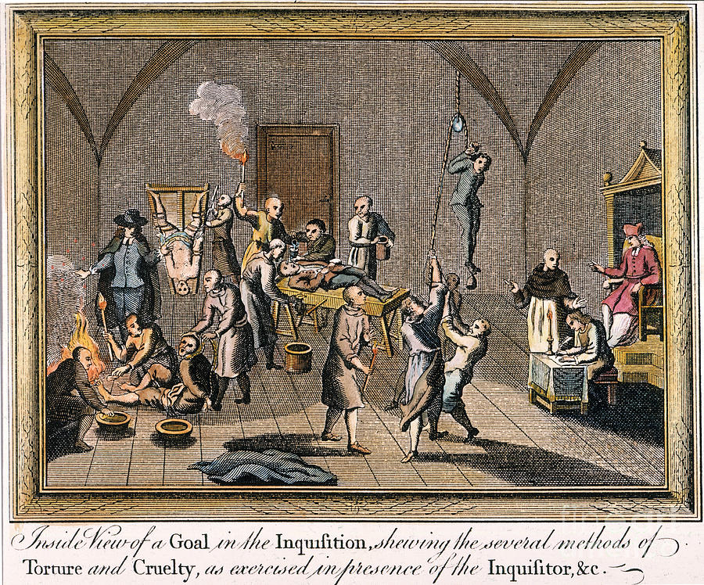
B. Religious Unity
Creation of the Tribunal of the Inquisition (1478) - institution which ensured Catholic orthodoxy and pursued heretics and Judaizers.
Forced both the Jews (1492) and Granada’s Mudejares (1500) to leave or convert to Catholicism.
Often used “less than orthodox methods” (i.e. torture and mutilation) to achieve their aims. - Over 150,000 people charged with crimes - 5,000 people executed for heresy

Slide 7
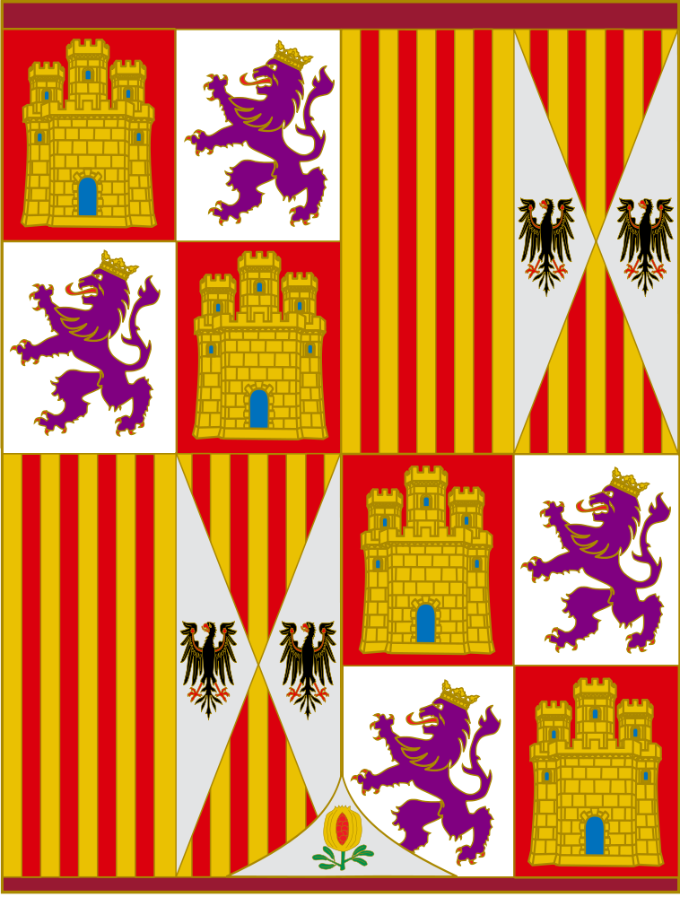
C. Establishment of the Modern State
The CM imposed their authority over the nobility, clergy and municipalities - established an authoritarian monarchy.
→ Reduced municipal autonomy and created a centralised government.
Also reformed the administration:
Councils → administration
Chancillerías / Audiencias [royal courts in Granada and Valladolid] → justice
Santa Hermandad [Holy Brotherhood] → social order in rural areas
Army → permanent and better organised (e.g. tercios)

Slide 8
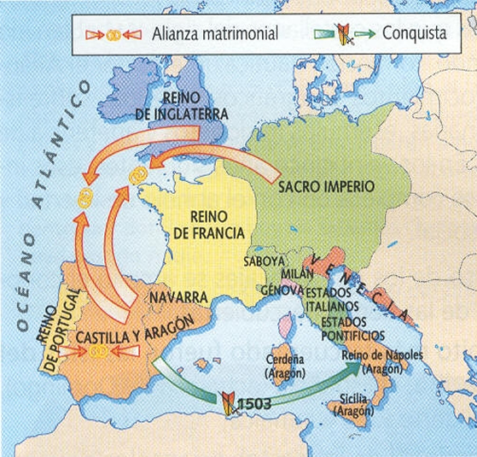
The Expansion of Castile and Aragon
Domestic Policy - Territorial Unification - Dominance of Catholicism
Foreign Policy
Marriage Alliances
Territorial Conquests

Slide 9
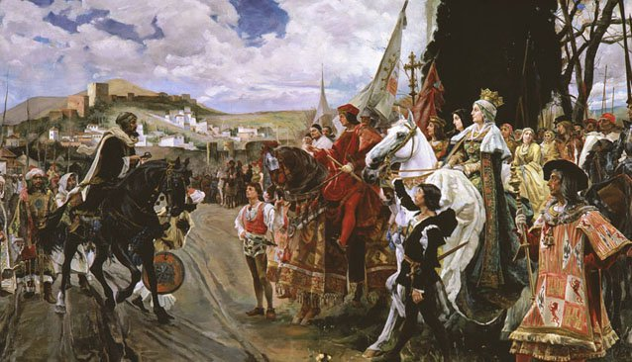
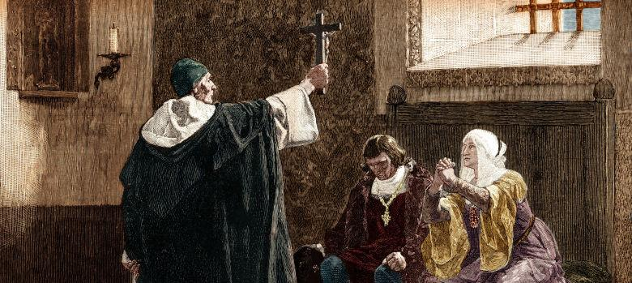
Domestic Policy
Their aim was to create a centralised government and achieve territorial unification.
Religious and Political Unity. Two channels: (1) same religion, and (2) defeat enemies.
Territorial Unification: conquered Granada (1492), Canarias (1496), and Navarra (1512).
Dominance of Catholicism: Spanish Inquisition (1478), Expulsion of the Jews (1492), Conversion of the Moriscos (1502).

Slide 10
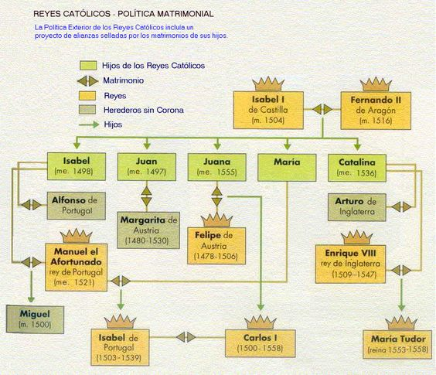
Foreign Policy: Marriage Alliances
Creation of international alliances through their children’s marriages. - Portuguese Crown - English Crown (Tudors) - Holy Roman Empire (Habsburgs of Austria)
Powerful allies in war and diplomacy → sources of gold, weapons, influence

Slide 11
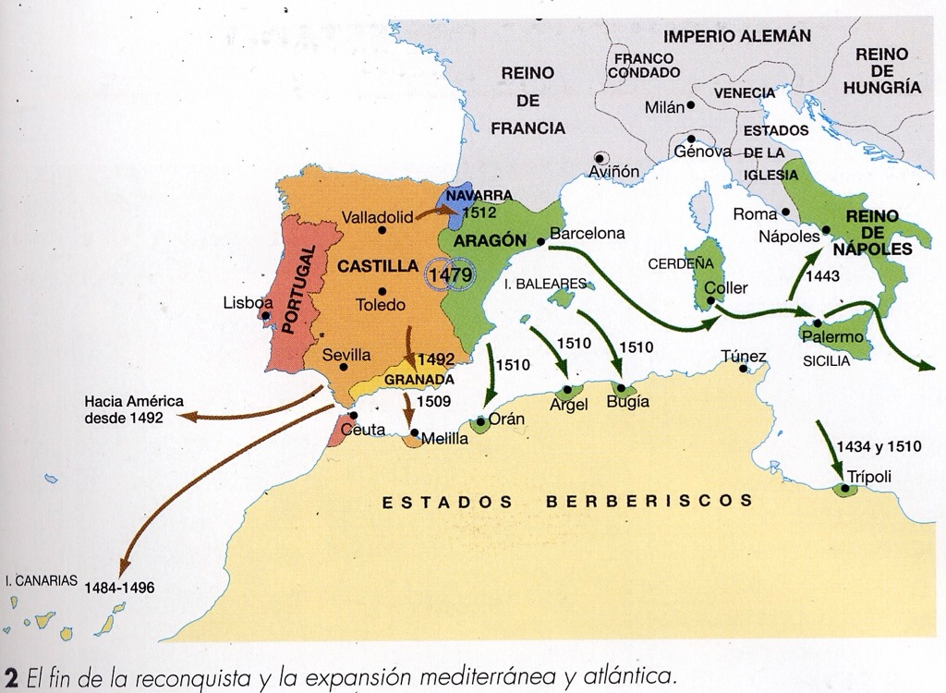
Foreign Policy: Territorial Conquests
Expansion into Africa, the Atlantic and Europe.
Castilla: conquered fortresses in North Africa and expanded into the Atlantic.
Aragón: rivalry with France and continued expanding into Europe.

