Slide 1
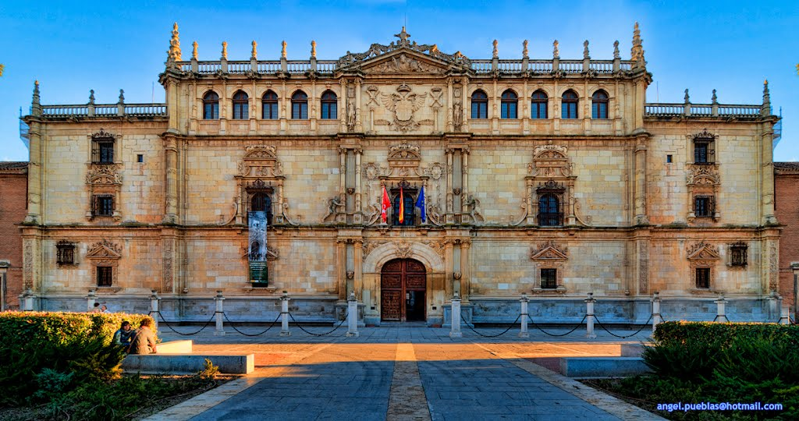
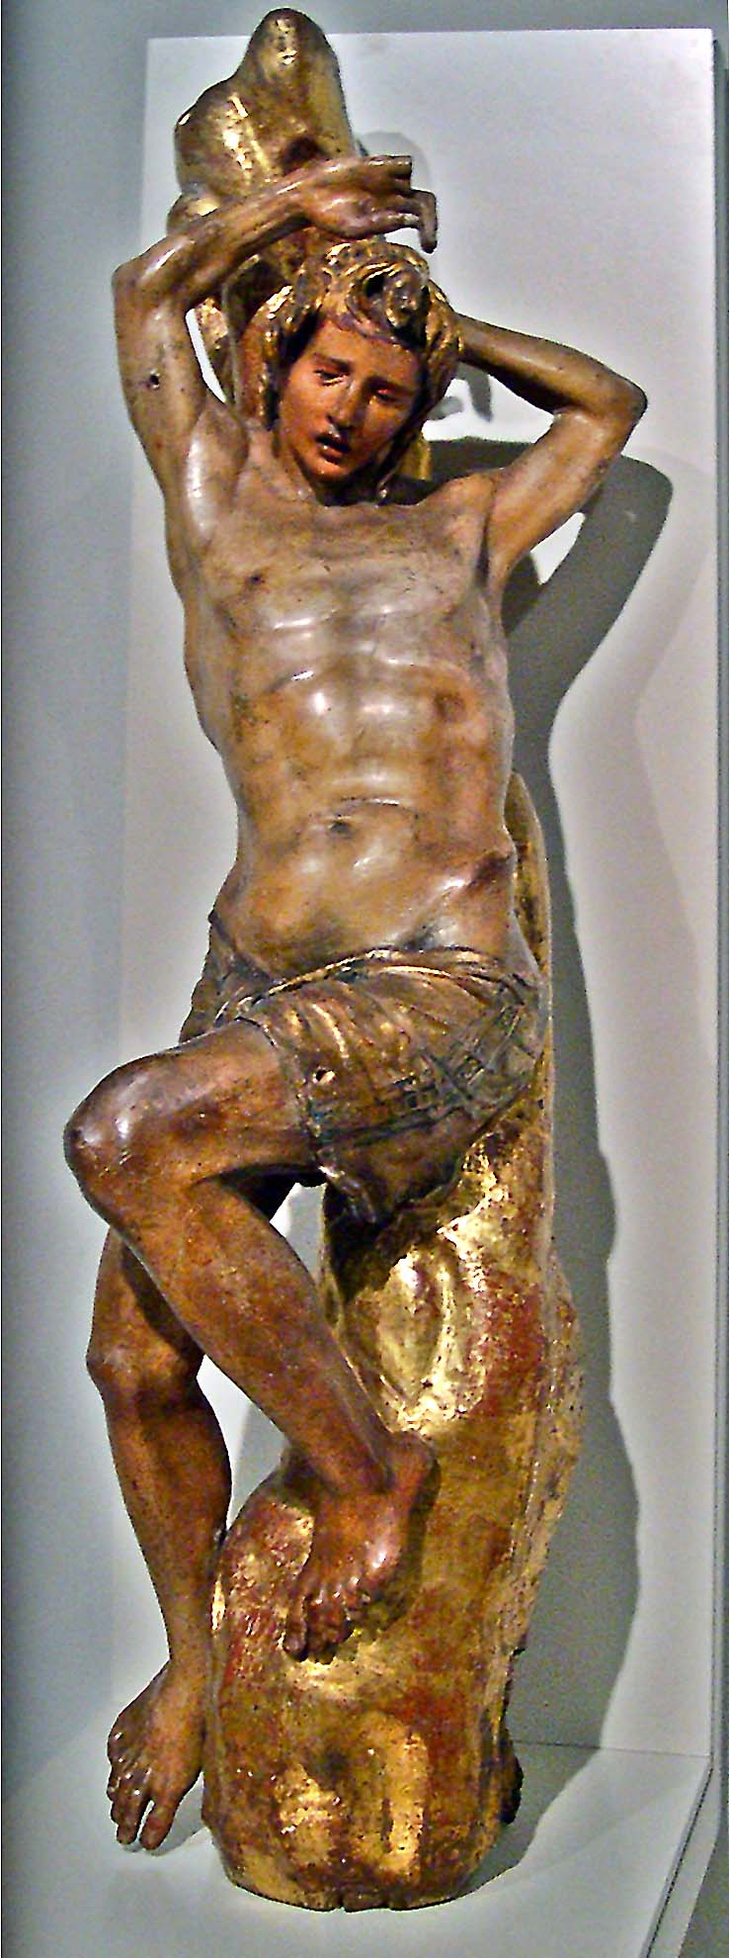
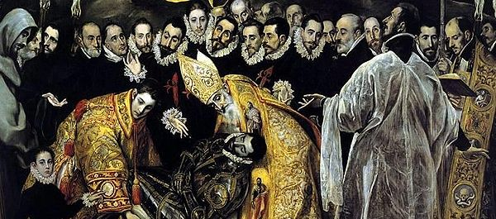
6.7 The art of the Golden Age

Slide 2
6.7 The art of the Golden Age
The Golden Age is the most flourishing period of Spanish culture.
When? 16th and 17th centuries.
Why? Spread of Humanist ideas and universities (Alcalá, Salamanca, Valladolid…).
Who?
Area | Prominent figures
Humanist thinkers | Luis Vives, Beatriz Galindo, Antonio de Nebrija
Writers | Garcilaso de la Vega, Santa Teresa de Jesús, San Juan de la Cruz
Scientists | Miguel Servet
Architects | Juan de Herrera
Sculptors | Alonso Berruguete
Painters | El Greco

Slide 3
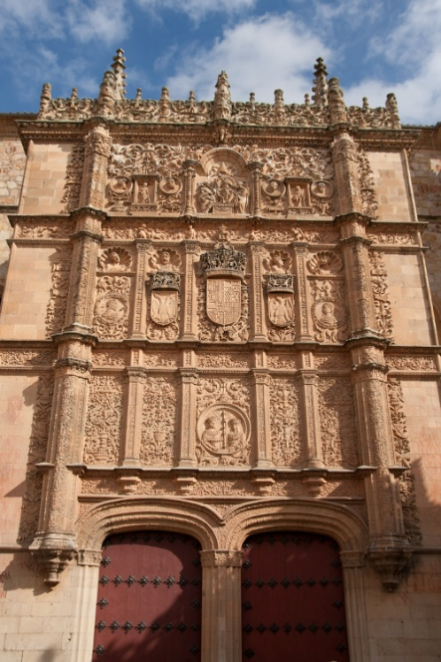
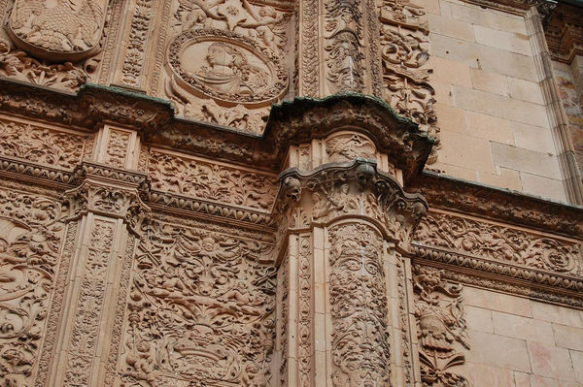
6.7 The art of the Golden Age
Renaissance architecture:
Inspired by Italian models and distinguished by three periods:
Plateresque style (1500-1530):
Mixed Gothic and Renaissance decoration,
Façades with medallions and shields,
It simulates the work of a silversmith
(platero).
University of Salamanca.

Slide 4
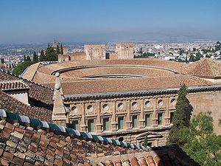
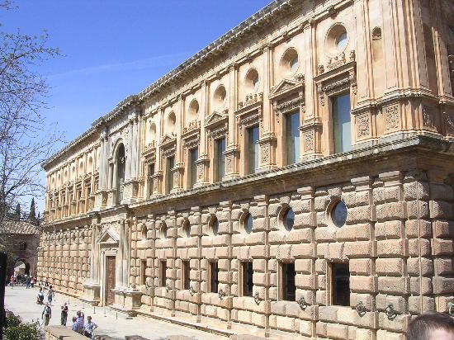
6.7 The art of the Golden Age
Classicism (1530-1560):
Elements of the Italian Renaissance architecture but simplified.
The palace of Charles I in Granada and the University of Alcalá de Henares.

Slide 5
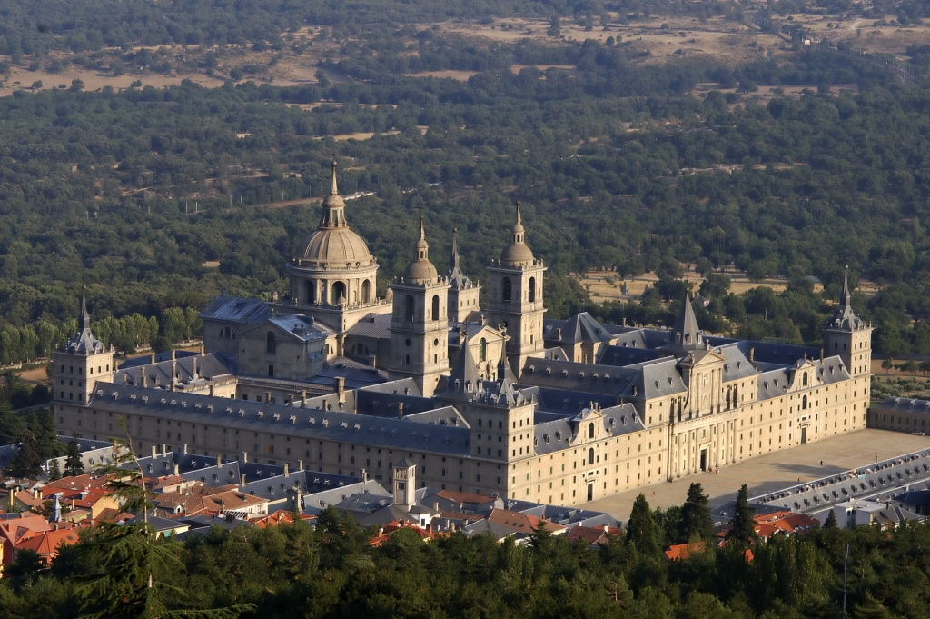
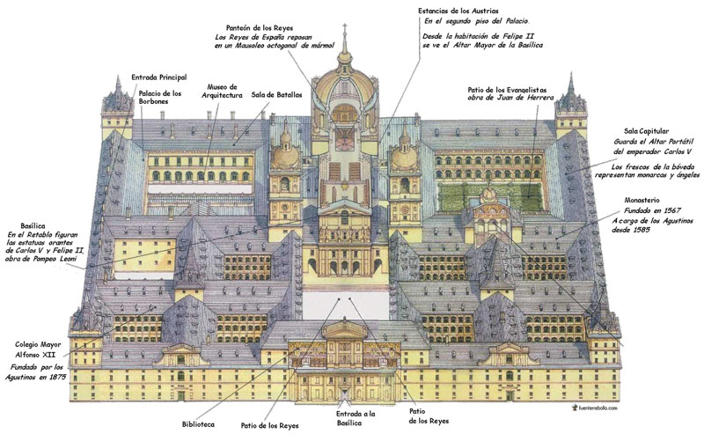
6.7 The art of the Golden Age
Herrerian style (1560-1600):
Developed by Juan de Herrera,
Simple forms, slate roofs and scarce decoration.
Monastery-palace of El Escorial.

Slide 6
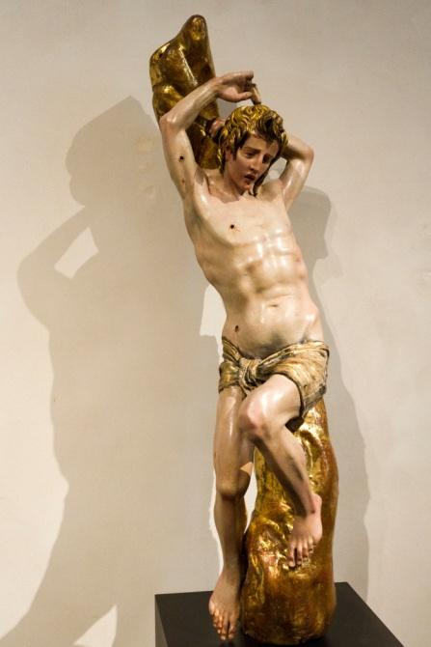
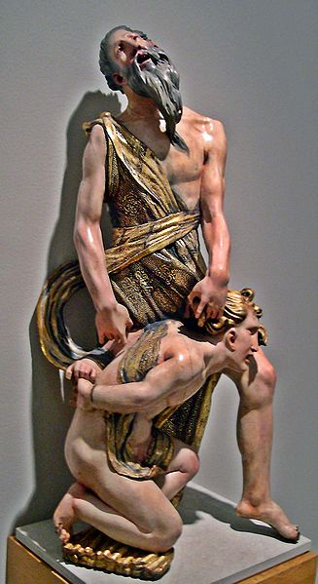
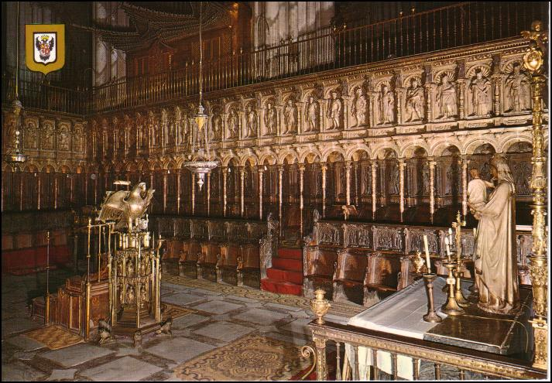
6.7 The art of the Golden Age
Renaissance sculpture:
Characteristics:
Distinctive style with polychromed wooden sculptures,
Intended to for altarpieces or religious processions;
Dramatic religious themes,
Expression of feelings,
Alonso de Berruguete is the most important sculptor of this time: Martyrdom of Saint Sebastian, The sacrifice of Isaac and the choir of the
Cathedral of Toledo.

Slide 7
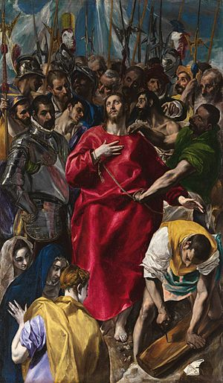
6.7 The art of the Golden Age
Renaissance painting:
Characteristics:
Domenikos Theotocopuli, El Greco (1541-1614), was the greatest painter of this time.
His figures have elongated proportions;
Complex compositions and twisted figures;
Unreal light and cool colours (blue, grey, green, violet…).
Religious themes (Ideas of the Catholic Counter-Reformation) and portraits.
The disrobing of Christ / El Expolio

Slide 8
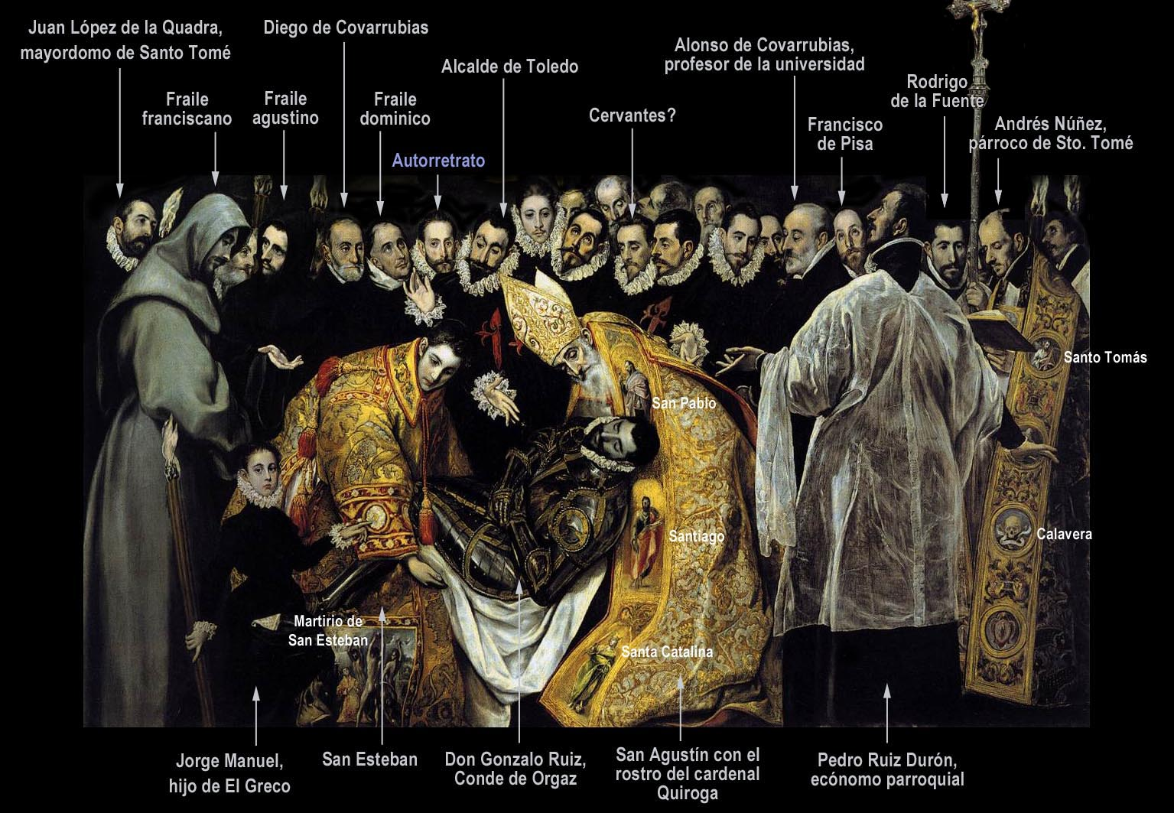
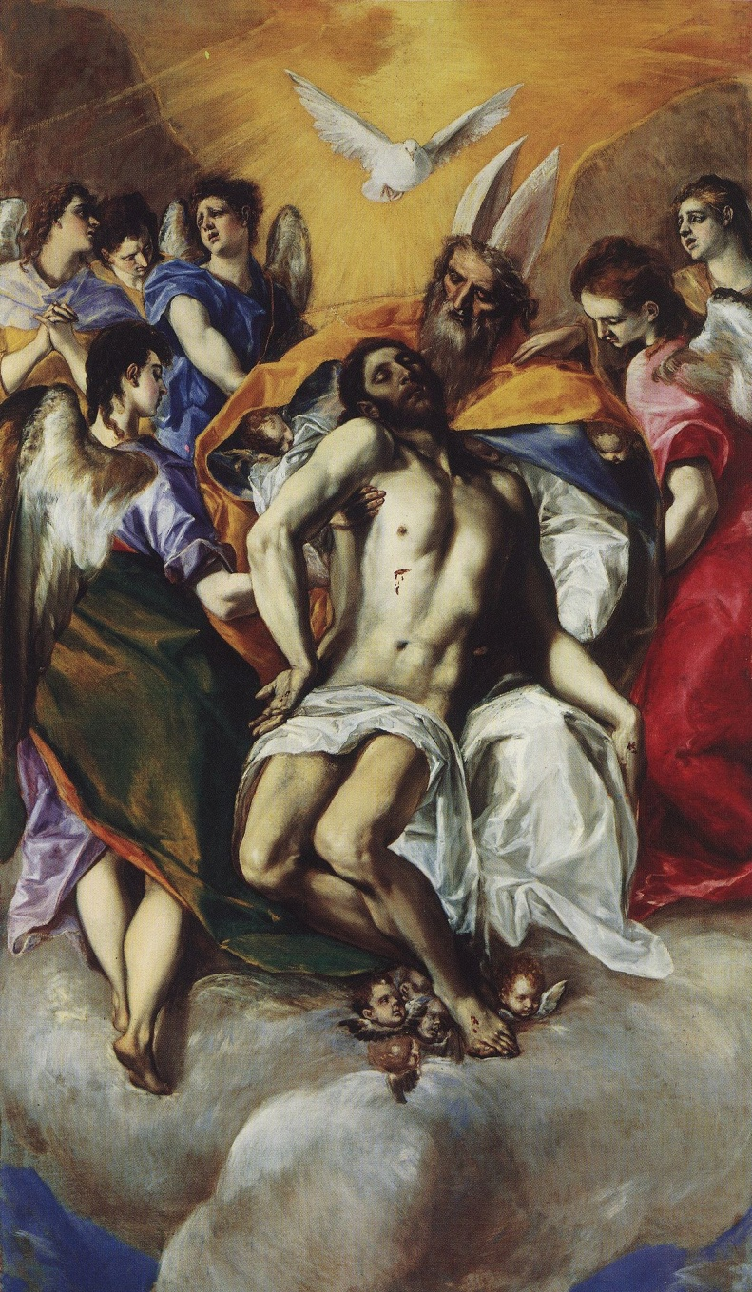
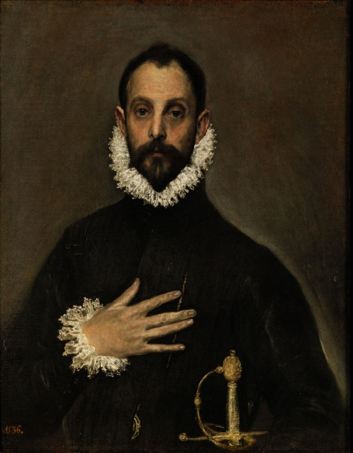
The burial of the Count of Orgaz/ El entierro del Conde de Orgaz.
The Nobleman with his hand on his chest / El caballero de la mano en el pecho.
The Trinity / La Trinidad.

