Slide 1
Convention on the Elimination of All Forms of Discrimination against Women

Slide 2
INDEX - Whats is the CEDAW? - States parties - Country reports - Concluding observations of the CEDAW
Convention on the Elimination of All Forms of Discrimination against Women

Slide 3
What is the CEDAW? We can define it as a bill of rights for women. In its 30 articles it defines what is discrimination against women and sets up an agenda to end that discrimination. It defines discrimination as "...any distinction, exclusion or restriction made on the basis of sex which has the effect or purpose of impairing or nullifying the recognition, enjoyment or exercise by women, irrespective of their marital status, on a basis of equality of men and women, of human rights and fundamental freedoms in the political, economic, social, cultural, civil or any other field." It´s under the responsibility of the Office of the High Commisioner for Human Rights (OHCHR).
Convention on the Elimination of All Forms of Discrimination against Women

Slide 4
States parties When a State accepts the Convention it commits to: - incorporate the principle of equality of men and women in their legal system, abolish all discriminatory laws and adopt appropriate ones prohibiting discrimination against women; - establish tribunals and other public institutions to ensure the effective protection of women against discrimination; and - ensure elimination of all acts of discrimination against women by persons, organizations or enterprises.
Convention on the Elimination of All Forms of Discrimination against Women

Slide 5
In that case the State party is legally bound to put the Convention´s provisions into practice. At the same time, every four years they are forced to submit a report on the measures taken to comply with their obligations to CEDAW.
Convention on the Elimination of All Forms of Discrimination against Women

Slide 6
Concluding observations of the CEDAW It´s a report that the Convention elaborates based on each State party´s report. The structure of the concluding observations is divided into three main parts: A. Introduction B. Positive aspects C. Principal areas of concern and recommendations
Convention on the Elimination of All Forms of Discrimination against Women

Slide 7
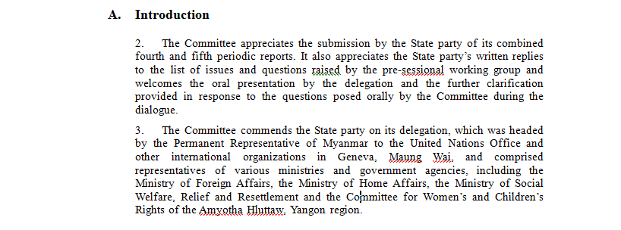
INTRODUCTION: CEDAW thanks the submission of the report and recognizes the work of the diplomatic delegation of the State party.
Convention on the Elimination of All Forms of Discrimination against Women

Slide 8
POSITIVE ASPECTS The Convention underlines the importance of the progress made by the State party on the issues related to gender equality, end of discrimination against women and women´s protection. - Welcoming accession of the State party to international treaties. - Welcoming legislative measures that implement equality and no discrimination. - Welcoming institutional or political measures to comply its obligations to CEDAW.
Convention on the Elimination of All Forms of Discrimination against Women

Slide 9
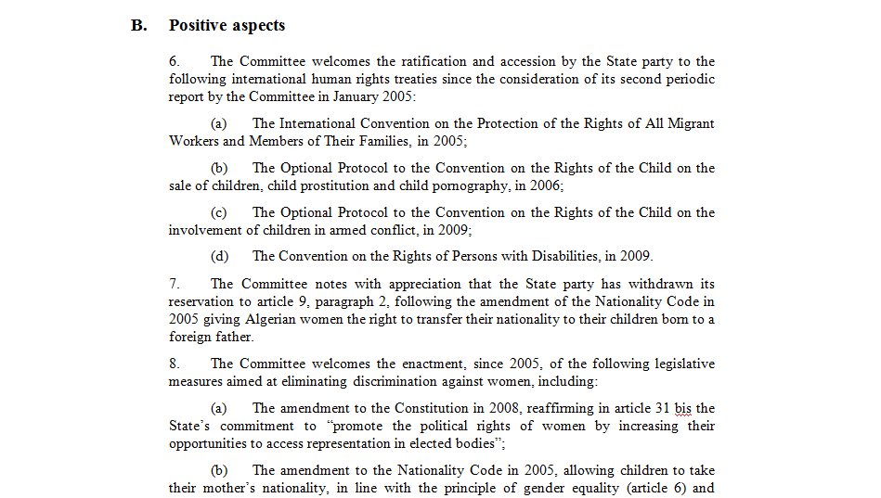
Convention on the Elimination of All Forms of Discrimination against Women

Slide 10
PRINCIPAL AREAS OF CONCERNS AND RECOMMENDATIONS In this part the report expresses its concerns about those issues that the State party needs to improve in order to comply the Convention in topics such as: - Definition of discrimination against women - Discriminatory laws - Legal complaint mechanisms - National machinery for the advancement of women - Stereotypes - Violence against women - Trafficking and sexual exploitation - Participation in political and public life - Education, employment, health… - Rural women - Marriage and family relations - Etc. For each of these issues the Convention gives specific recommendations to the State party
Convention on the Elimination of All Forms of Discrimination against Women

Slide 11
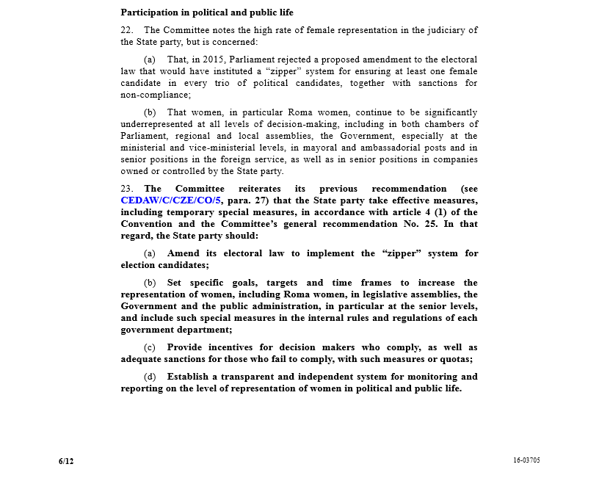
Convention on the Elimination of All Forms of Discrimination against Women

Slide 12
SOURCES - CEDAW official websites: http://www.un.org/womenwatch/daw/cedaw/ (27/10/2016) http://www.ohchr.org/EN/HRBodies/CEDAW/Pages/Comments.aspx (27/10/2016)
Convention on the Elimination of All Forms of Discrimination against Women

