Slide 1
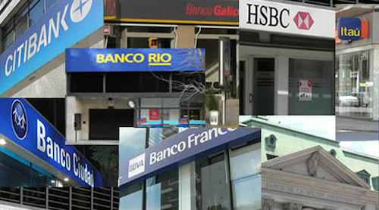
4.5 Financial activities
The financial sector comprises all the activities related to the movement and management of capital: money, credits, investments, currency exchange…
All these activities are undertaken by:
Banks: private and central banks (ECB, Banco de España…)
Insurance companies
The stock market

Slide 2
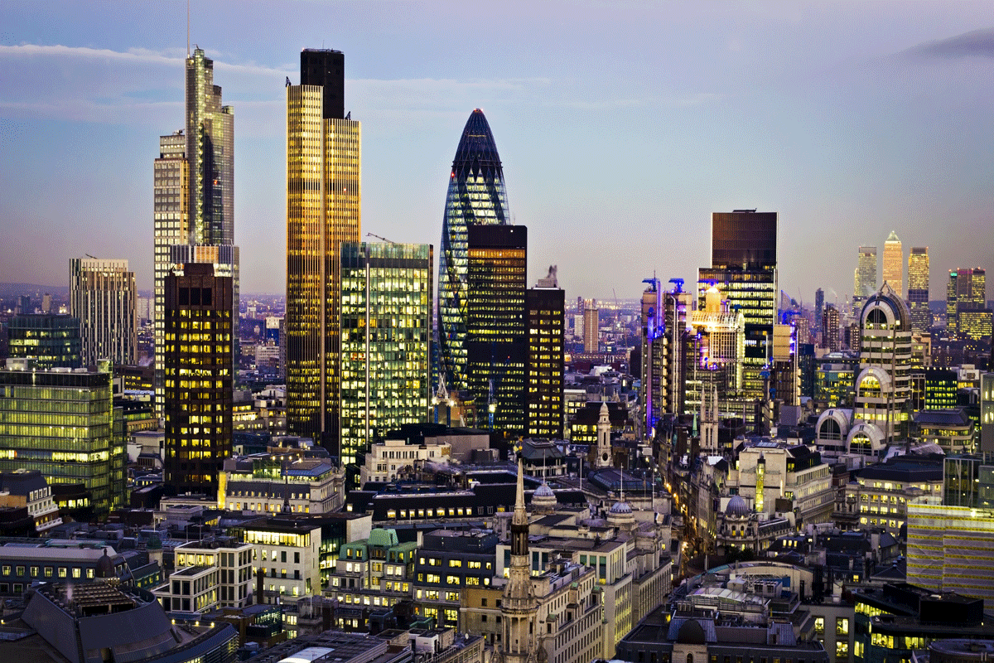
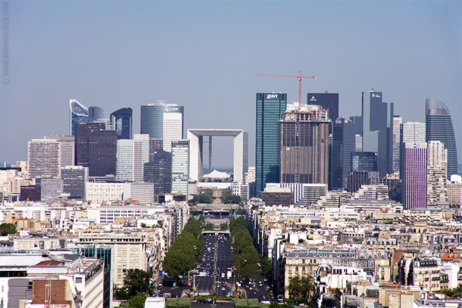
4.5 Financial activities
These services can be gathered in financial districts (London, New York, Paris) or spread on different parts of the city.

Slide 3
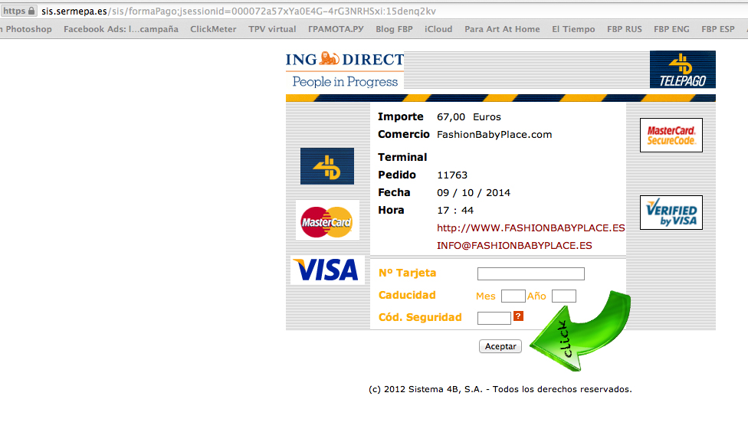
4.5 Financial activities
The financial sector has experienced a quick growth during the recent decades thanks to the development of communication technologies that allow its use anytime and almost everywhere.

Slide 4
4.5 Financial activities
Due to its importance the financial sectors also face problems that affect enormously the global economy:
The lack of regulation: money is a fictitious good and its flow requires the control of the authorities.
The speculation
Tax havens
The distribution of financial services in the world is unequal: in developed countries it is important in terms of GDP and labour force; in emerging countries it is growing fast pushed by the industrial development; while underdeveloped countries do not have an important financial sector.

