Slide 1
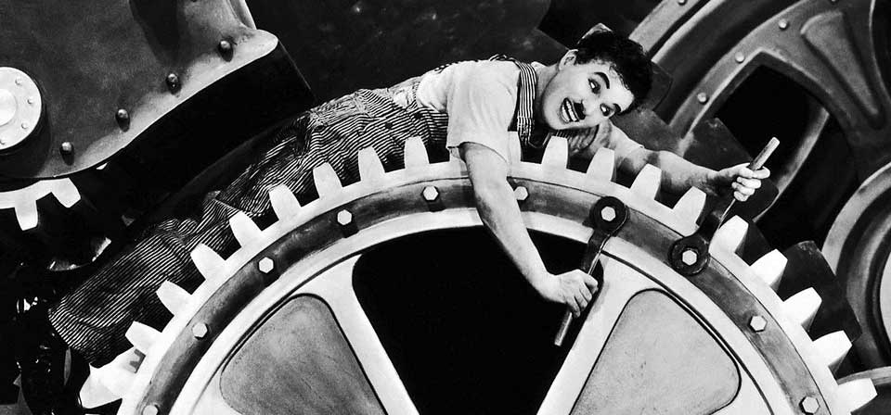
3.4 First and second industrial revolutions

Slide 2
3.4 First and second industrial revolutions
From a historical point of view manufacturing of raw materials can be divided into different periods:
Before 1770: Artisanal industry
1770-1870: First industrial revolution
1870-1950: Second industrial revolution
From mid 20th century: Third industrial revolution

Slide 3
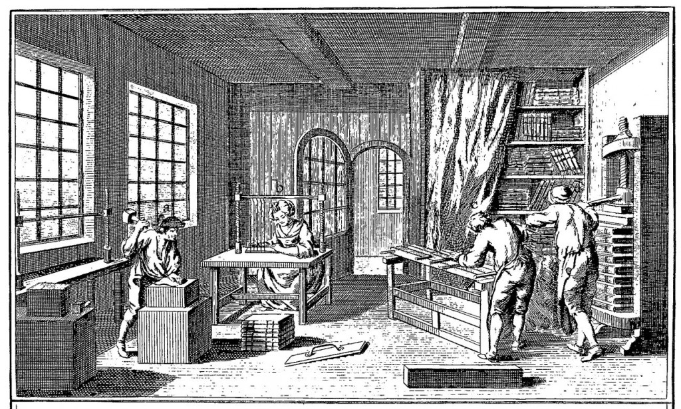
3.4 First and second industrial revolutions
Artisanal industry was undertaken by hand, with traditional tools and animal or human energy sources.
Artisans worked in small workshops and created unique products.
It was located in the
center of the cities.

Slide 4
3.4 First and second industrial revolutions
1770-1870: First industrial revolution
Modern industry appeared in Great Britain as a result of the combination of political, economic, social and technological factors. Among them the steam machine was one of the most important. Coal became the most used energy source.
Manufacture was undertaken in factories out of the city center and the products were abundant, cheap and homogenous.

Slide 5
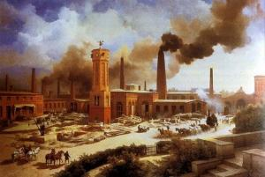
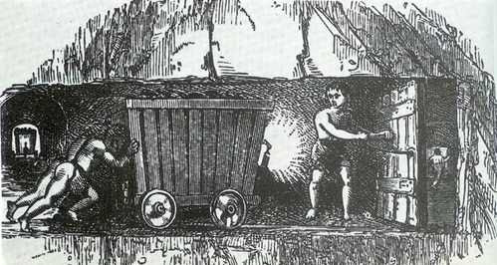
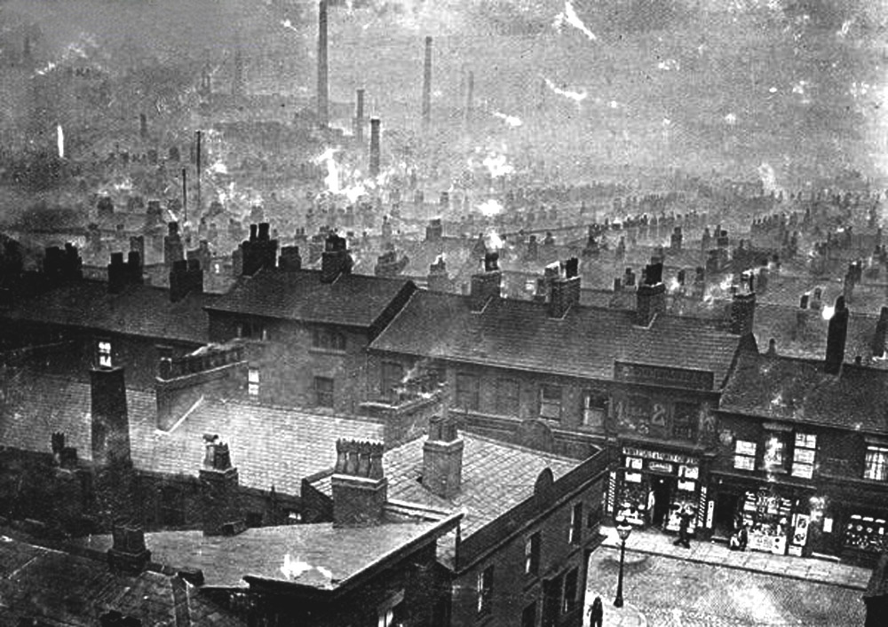
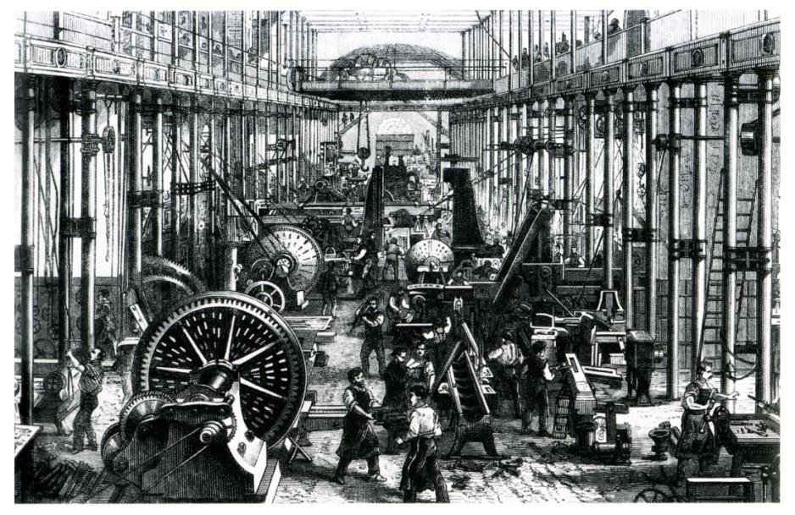
3.4 First and second industrial revolutions

Slide 6
3.4 First and second industrial revolutions
1870-1950: Second industrial revolution
In the mid 19th metallurgy and chemical industries developed in Europe.
Electricity started to be the main power force in factories and energy sources like oil became important for the industrial activity.
Industries were concentrated in the outskirts of the big cities in industrial estates.

Slide 7
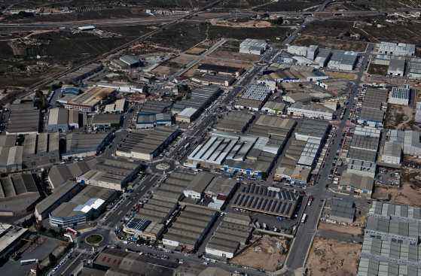
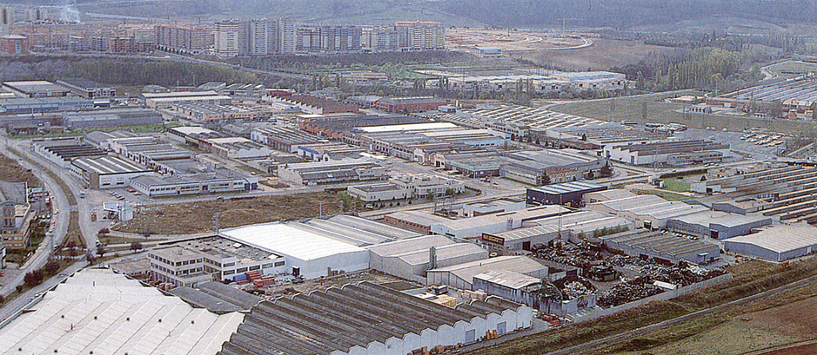
3.4 First and second industrial revolutions

Slide 8
3.5 Third industrial revolution and contemporary industry
From mid 20th century: Third industrial revolution
The innovations that led to the Third Industrial revolution were:
New technologies: microelectronics, computer systems…
Industrial robots
New materials
New energy sources: nuclear and renewable
New industrial sectors: telematics, aeronautics, biotechnology…

Slide 9
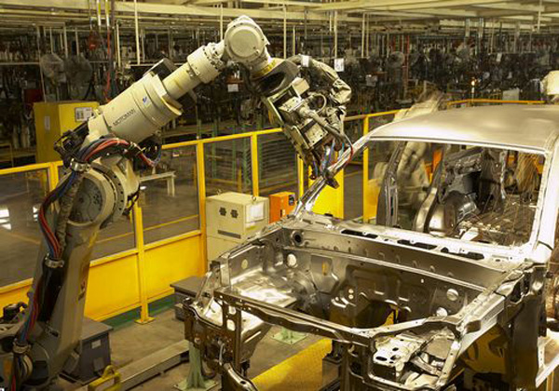
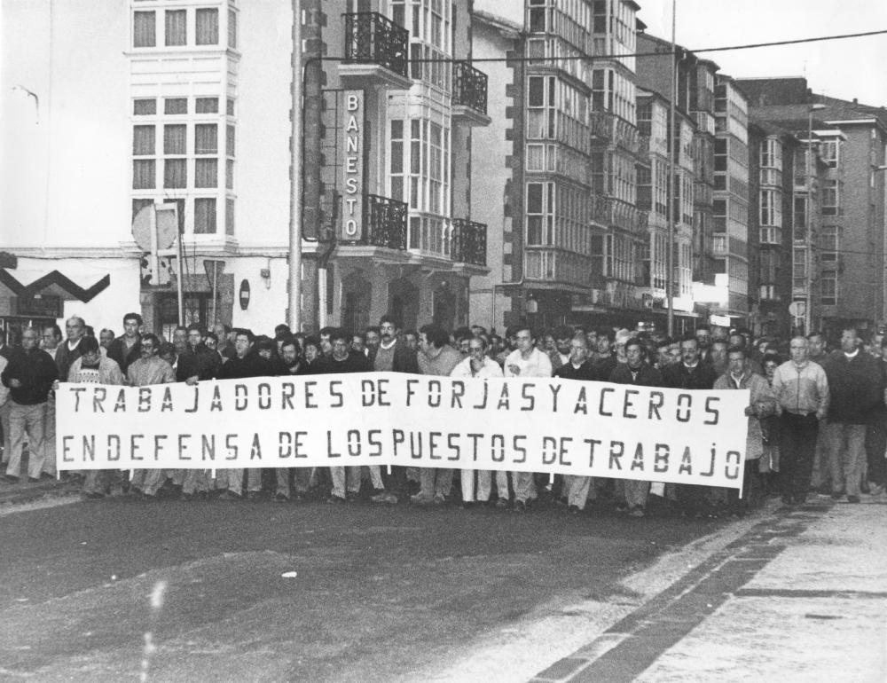

Slide 10
3.5 Third industrial revolution and contemporary industry
Traditional industries (those that had appeared during the first and second industrial revolutions) underwent a crisis in the 1970s with three main consequences:
Reconversion: closure or changes in production and labor force.
Reindustrialisation: attraction of new industries in some areas.
Relocation/offshoring: moving of some parts of the production process to cheaper areas.

Slide 11
3.5 Third industrial revolution and contemporary industry
In developed countries high-tech industries have been established in science parks.
In recently industrialised countries big complexes have been created. Generally there is not environmental legislation so they host highly polluting industries.

Slide 12
