Slide 1
5.5 The Russian revolution (1917)
The Russian Empire experienced the first succesful and lasting revolution based on the marxist ideas. Causes:
Political causes: the tsar Nicholas II ruled as an absolut monarch held by the Orthodox Church.
Opposition to the tsarist regime was used by the marxist Russian Social Democratic Labour Party. This party split into two wings:
a) The Bolsheviks: led by Lenin that promoted a revolutionary way.
b) The Mensheviks: led by Martov who followed a reformist path.

Slide 2
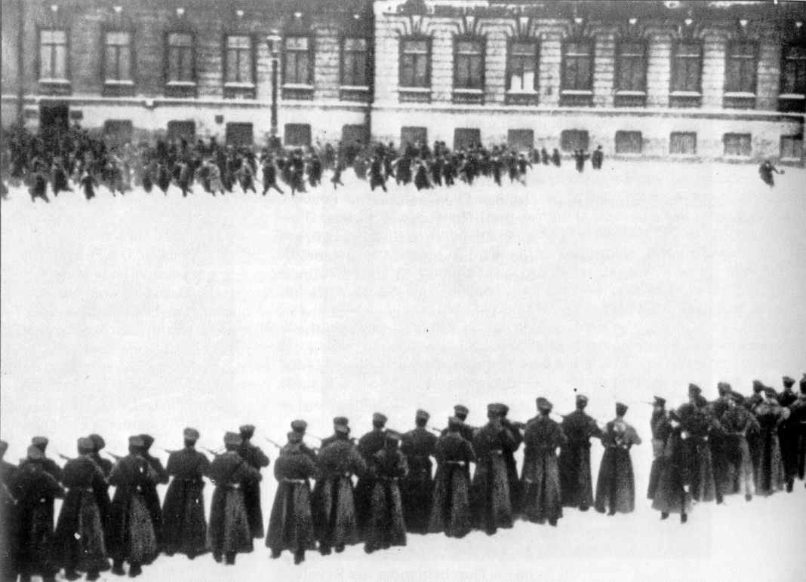
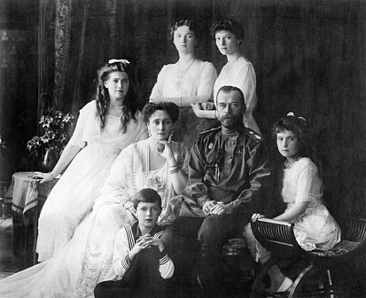
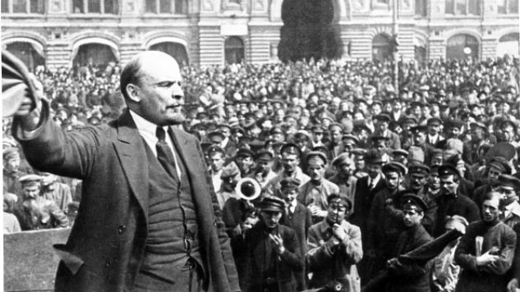
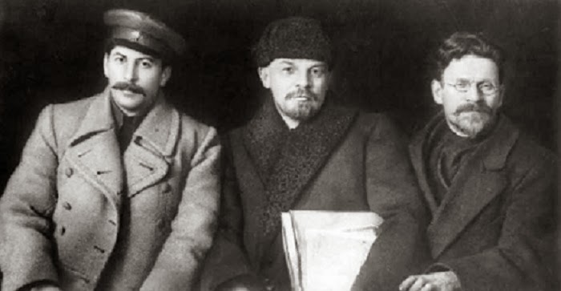

Slide 3
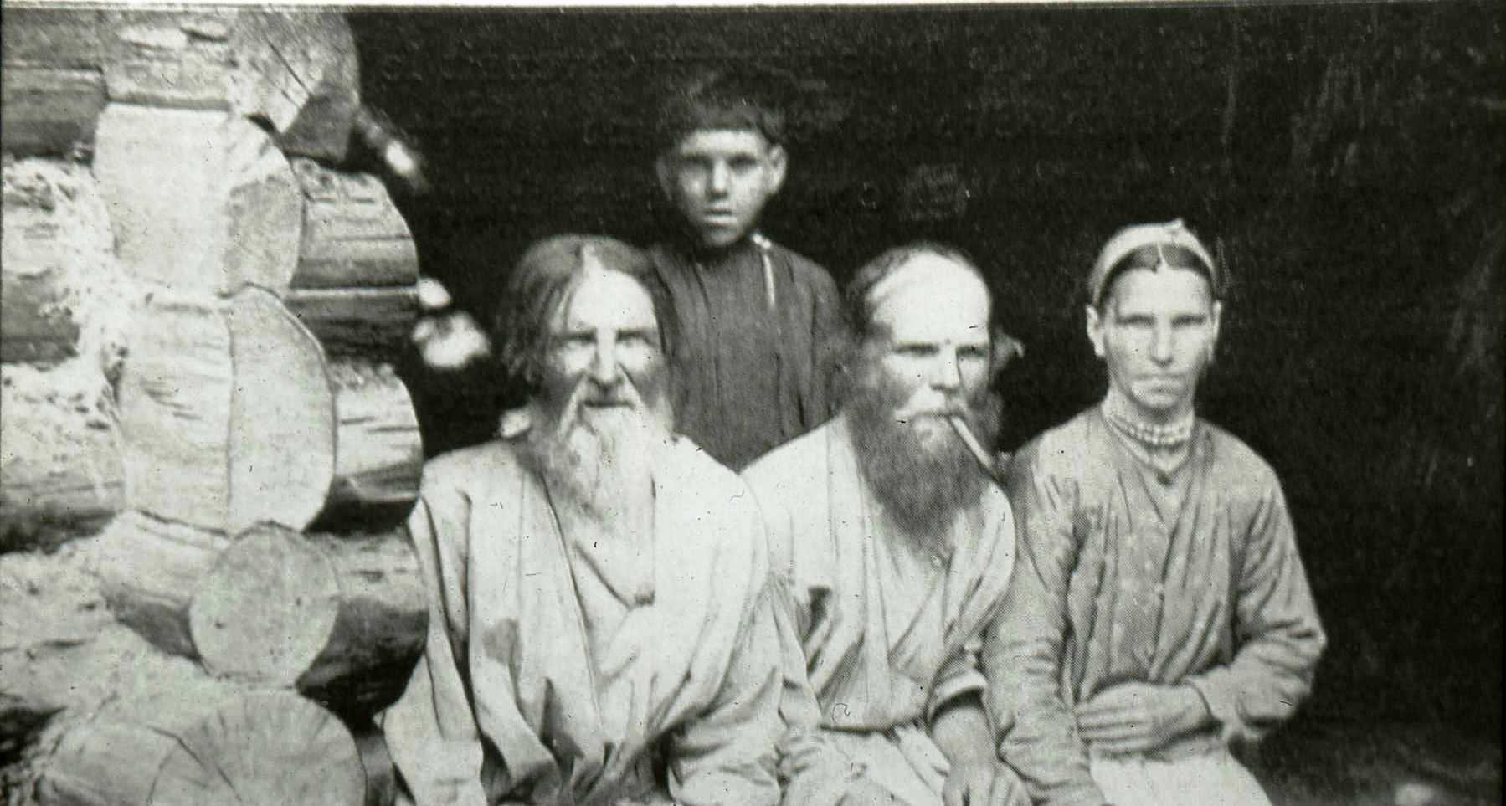
5.5 The Russian revolution (1917)
Social causes: a vast majority of Russian population were peasants in miserable conditions exploited by the landowner nobility.
Only in the cities of Petrograd and Moscow industrialisation had begun. Popular discontent drove to a failed revolution in 1905 brutally repressed by the tsarist forces.

Slide 4
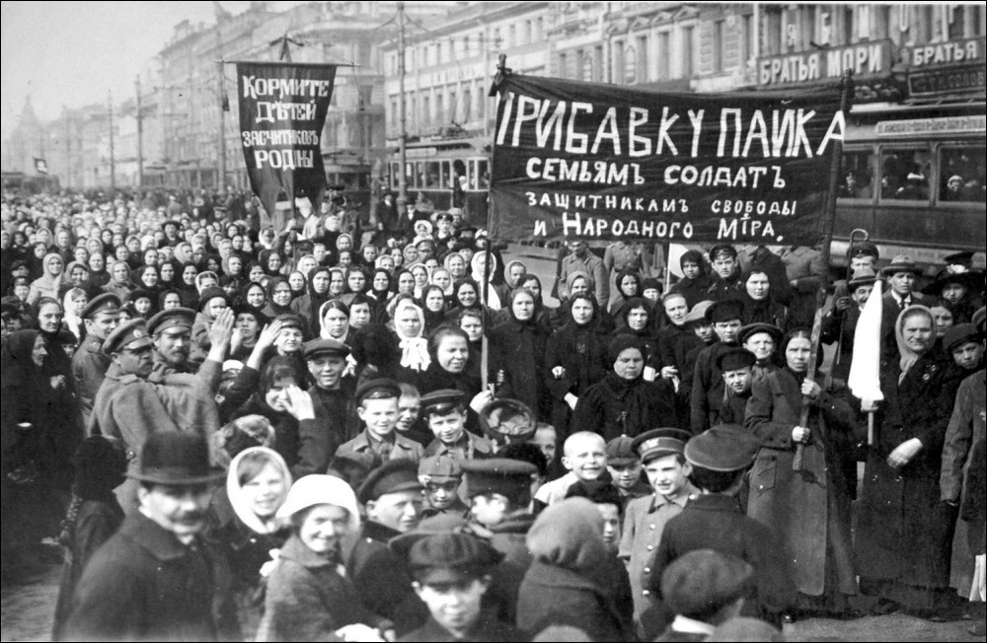
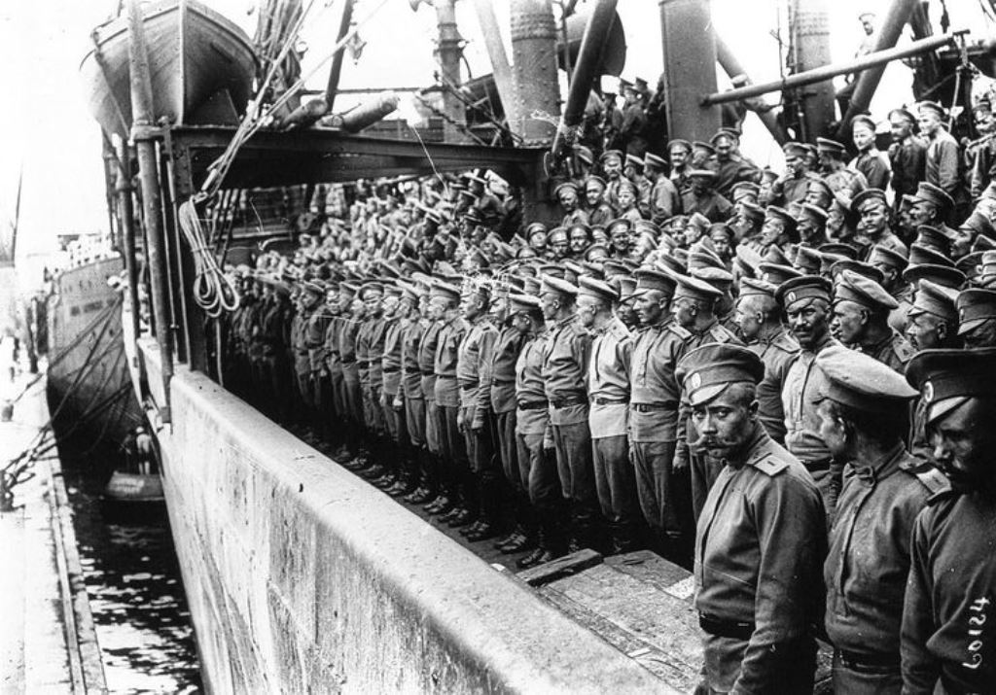
5.5 The Russian revolution (1917)
The First World War: Russia was not prepared for the war. Its army was obsolete, its transport system was inefficient and its industry could not respond the demand.
In order to provide economic resources to the war effort, food shortages and famines appeared in the country. This led to unrest among workers, peasants and soldiers (mutinies became common).

Slide 5
5.5 The Russian revolution (1917)
The February revolution
A huge demonstration in Petrograd, a general strike and riots in the army led to the abdication of the tsar and the proclamation of the republic. The bourgeois parties took the power and initiated some reforms.
Nevertheless, it had the opossition of the Soviets: assemblies of workers, peasants and soldiers that supported the Bolsheviks.

