Slide 1
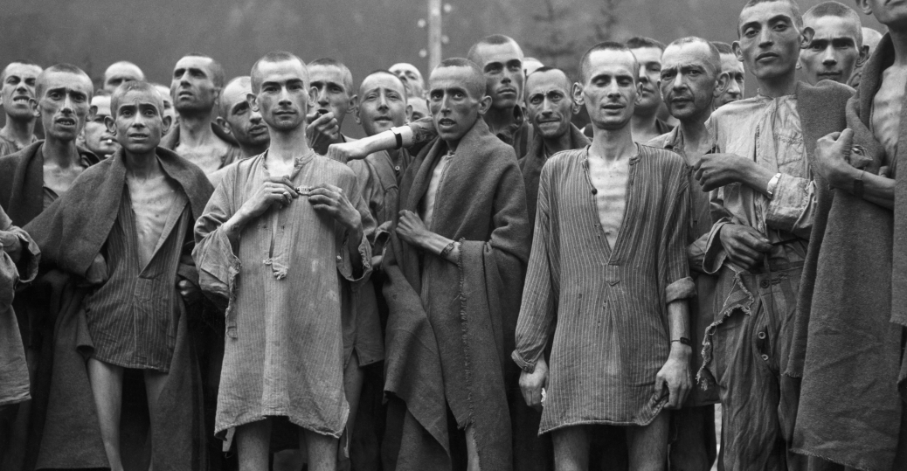
6.5 The Holocaust

Slide 2
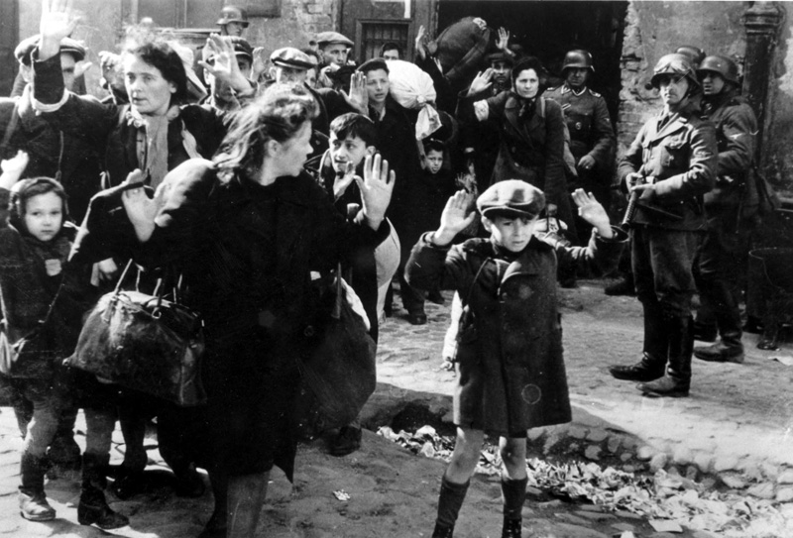
6.5 The Holocaust
Nazi ideology promoted ideas of racism, authoritarianism and superiority of some groups above others.
These theories were terribly put into practice in the countries occupied by Germany and especially in the extermination camps.

Slide 3
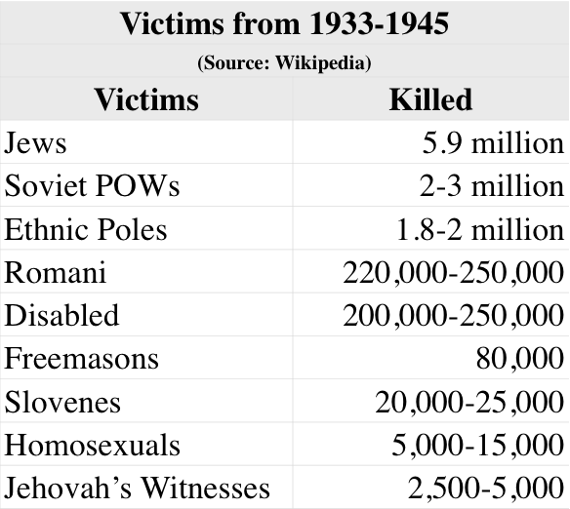
6.5 The Holocaust

Slide 4
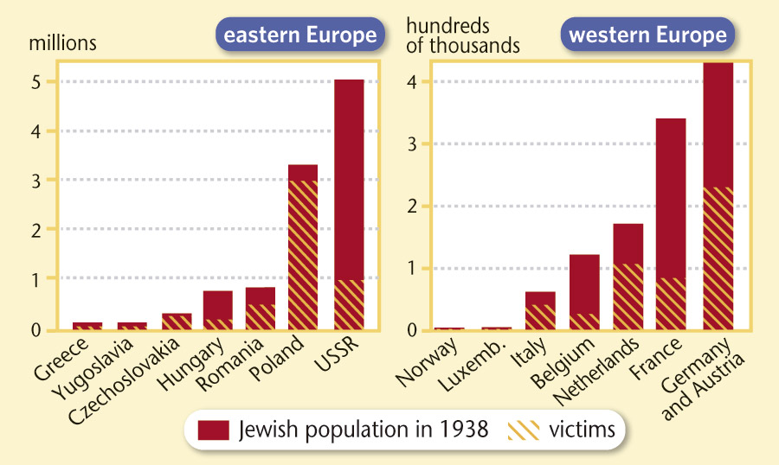
6.5 The Holocaust

Slide 5
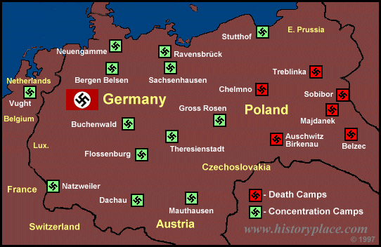
6.5 The Holocaust
Jews were who suffered the most. In 1942 Nazis planned the “Final Solution”, a system of mass concentration and extermination camps.

Slide 6
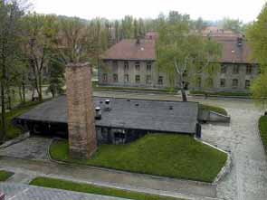
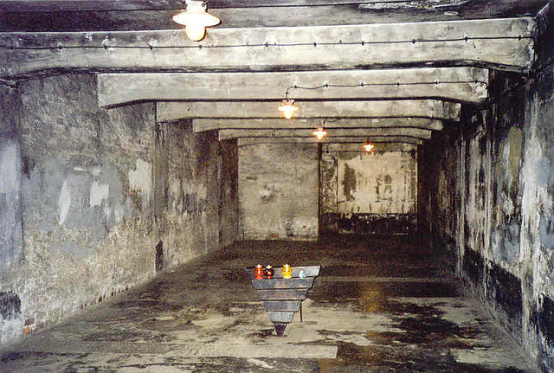
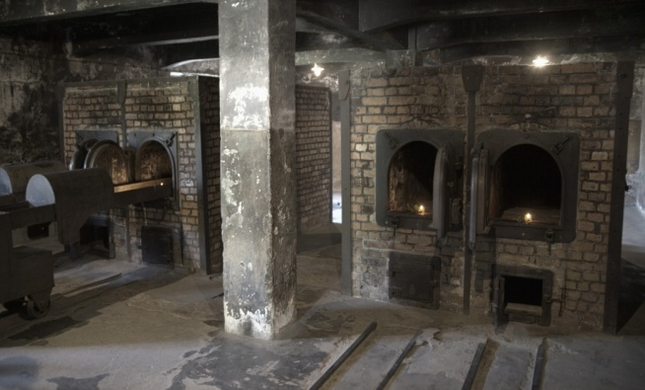
6.5 The Holocaust
The extermination camps were factories of torture and death. Prisoners were hardly fed or dressed and forced to perform hard labour, tortured, subjected to medical experiments and murdered.
The most common way Nazis used to kill Jews were the gas chambers.

Slide 7
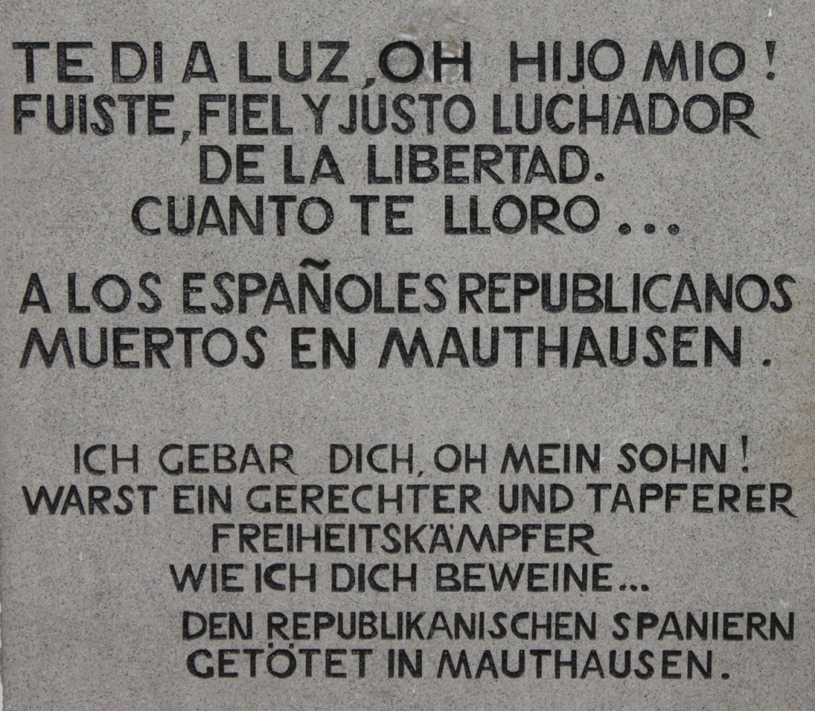
6.5 The Holocaust
5,500 out of 9,000 Spanish republican political prisoners were killed at Mauthausen concentration camp in Austria.

