Slide 1
6.1 Success and failure of the League of Nations
1920 - 1945

Slide 2
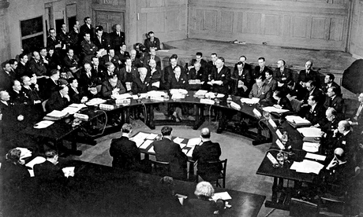
Introduction
Founded on 10th of January 1920
Consequence of the Paris Peace Conference after WWI
First international attempt of an intergovernmental organisation

Slide 3
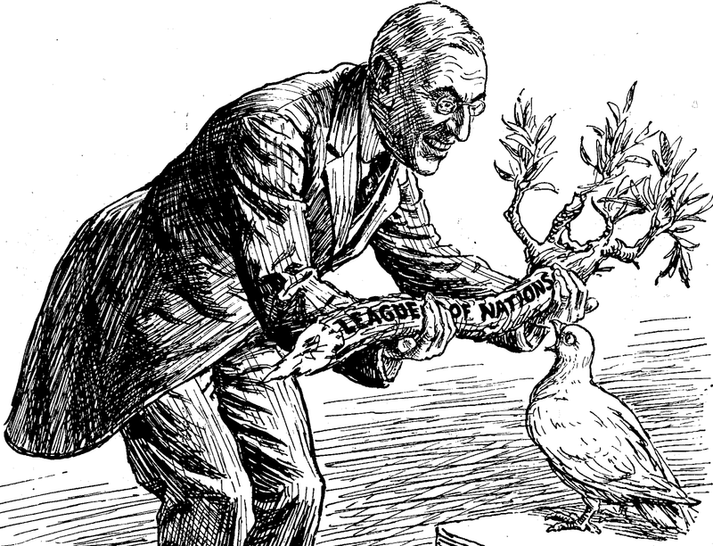
The League’s Purpose
The League of Nation’s objectives were:
“To prevent aggression by any nation”
“To encourage cooperation between nations”
“To work towards international disarmament”
“To improve living and working conditions”
Diplomatic Relations
International Peace
Collective Security (Unity)

Slide 4
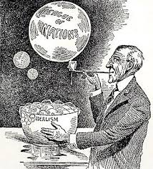
Woodrow Wilson’s 14 Points
USA wanted peace… France wanted revenge and Britain compensation for WWI
Based on Woodrow Wilson’s (US President) Idealistic 14 Points
1. Open diplomacy
2. Freedom of the Seas
3. Removal of Economic Barriers
4. Reduction of Armaments
5. Adjustment of Colonial Claims
6. Evacuation of conquered Russian territories
7. Preservation of Belgian sovereignty
8. Restoration of French territory (Alsace and Lorraine)
9. Redrawing of Italian frontiers
10. Division of Austria-Hungary
11. Redrawing of Balkan boundaries
12. Limitations on Turkey (Ottoman Empire and non-Turkish peoples)
13. Establishment of an independent Poland
14. Association of Nations [to be formed to guarantee to its members political independence and territorial integrity – genesis of the League of Nations]

Slide 5
The League of Nations’ Historical Record
TERRITORIAL
NON- TERRITORIAL
Successes
Aaland Islands 1921 (Sweden vs. Finland)
Saarland 1920-1935 (Germany)
Danzig 1920-1935 (Germany)
Border Dispute 1925 (Greece vs. Bulgaria)
Failures
Vilna 1920 (Lithuania vs. Poland)
Corfu 1923 (Greece vs. Italy)
Manchuria 1931 (China vs. Japan)
Abyssinia 1935 (Abyssinia vs. Italy)
Spanish Civil War 1936-1939
Successes
Refugee Commission
Health Organisation
International Labour Organisation
Austrian Economic Recovery 1922
Failures
US refusal to join
Unequal structure (veto power and no army)
Germany and USSR not allowed to join at first
World War II

Slide 6
Successes

Slide 7
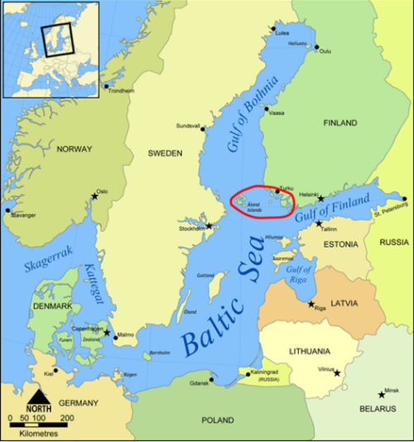
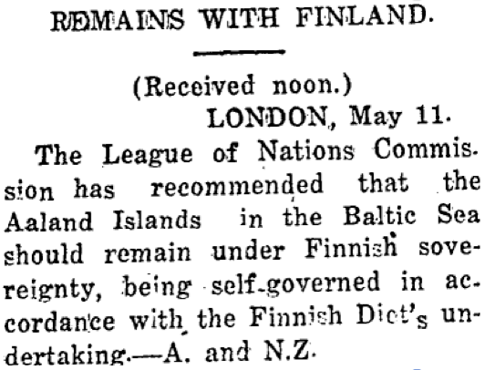
Aaland Islands 1921
Finnish Islands (had been Swedish until 1809)
Islanders wanted to belong to Sweden
Sweden and Finland on the verge of war
SOLUTION
League resolved issue in June 1921
Islands would remain Finnish yet demilitarised and both parties agreed to this.

Slide 8
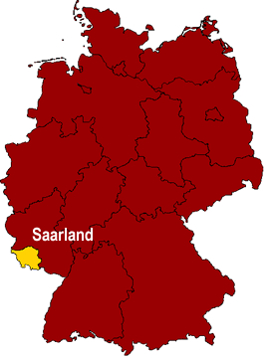
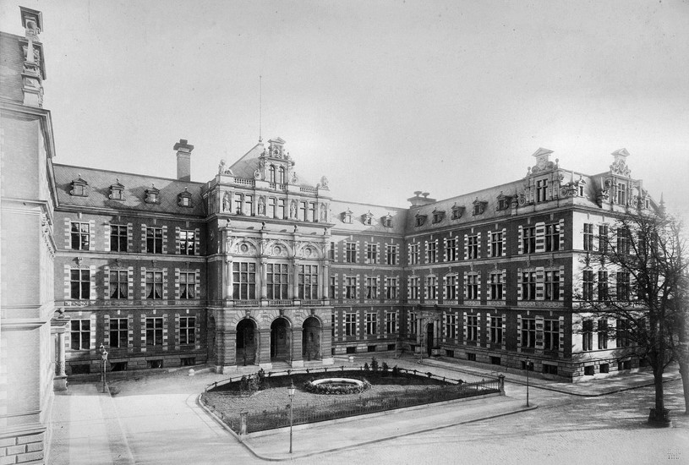
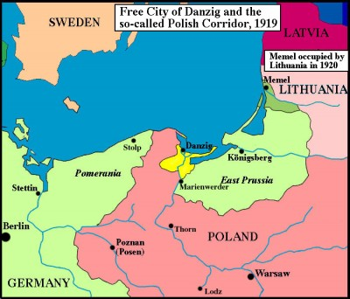
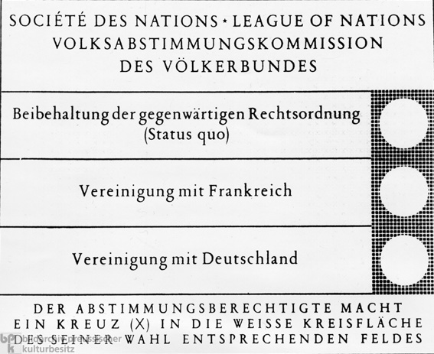
Saarland and Danzig (1920-1935)
Saarland
Under German control until 1920
Treaty of Versailles stated Saarland should be under LofN’s control for 15 years
SOLUTION
Referendum in 1935: 90.3% return to Germany
League supported this result (self-determination)
Danzig
Under German control until 1920
Treaty of Versailles stated Danzig should be under LofN’s control for 15 years
SOLUTION
Became Free City of Danzig in 1935
Free until Hitler’s invasion in 1939

Slide 9
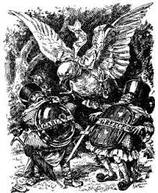
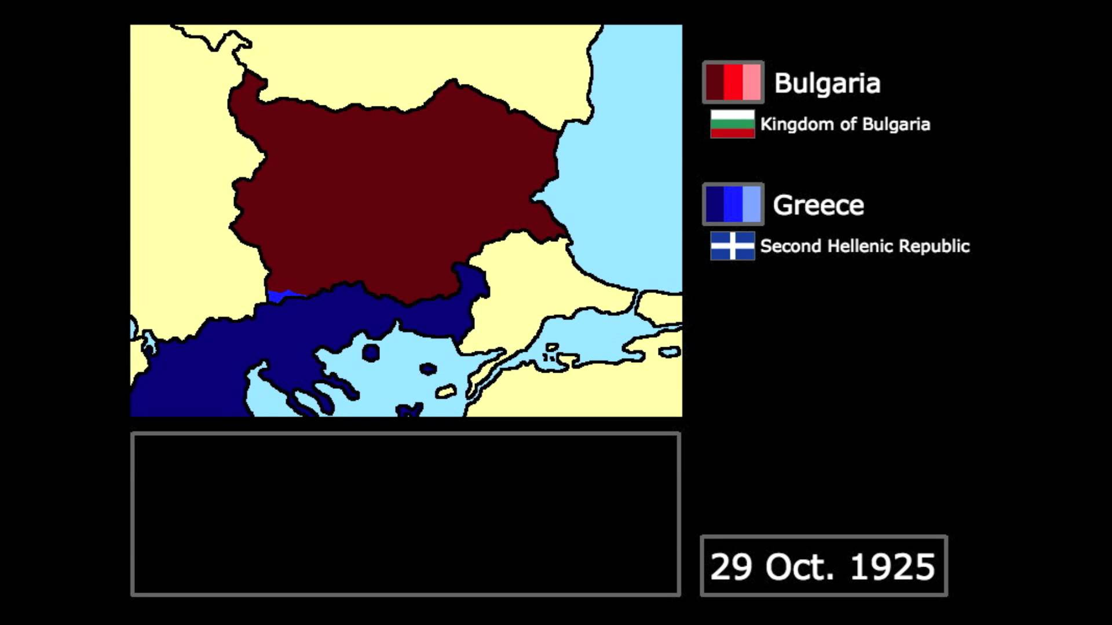
Greco-Bulgarian Border Dispute 1925
Bulgaria asked the League for help after Greek invasion
Both countries engaged in military conflict
SOLUTION
League decided Greece was to blame for the conflict
Both parties agreed and Greece paid £45,000 in compensations to Bulgaria

Slide 10
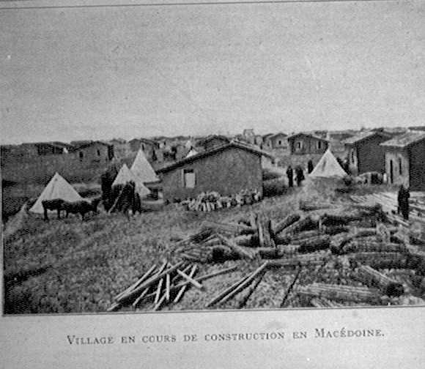
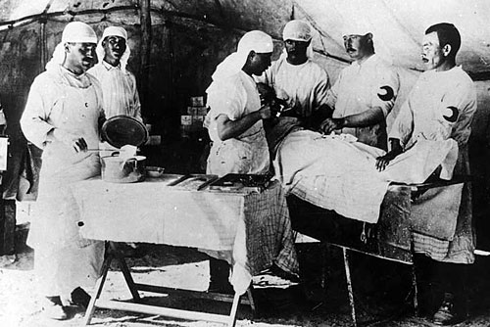
Refugee Commission
Health Organisation
Organised the return of 500,000 Russian Prisoners of War after WWI
Set up a refugee camp in Turkey to alleviate the 1918-1922 Turkish refugee crisis
Spent £10 m building farms and homes for refugees
Prevented spread of typhoid and cholera in camps
Reduced spread of leprosy worldwide
Introduced global vaccination programmes

Slide 11
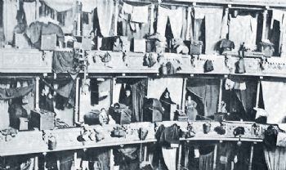
International Labour Organisation
Austrian Economy 1922
Improved working conditions worldwide
Introduced programmes to combat:
Child labour
Drug trafficking
Prostitution
Slavery
Supervised the reconstruction of the Austrian economy as from October 1922
Members (UK, France, Italy and Czechoslovakia) aided financially

Slide 12
Failures

Slide 13
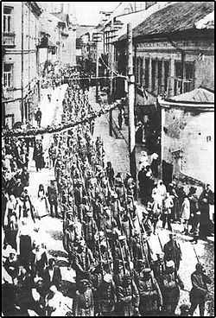
Vilna 1920 (Poland vs. Lithuania)
After WWI, Lithuania was re-established as a nation
Poles made up 30% of Vilna’s population
Poland invaded Vilna and Lithuania asked for help.
Poland ignored the League’s threats and Vilna remained Polish until 1945
PROBLEM
The League had no army and it depended on its members for military action - members did not want to get involved.

Slide 14
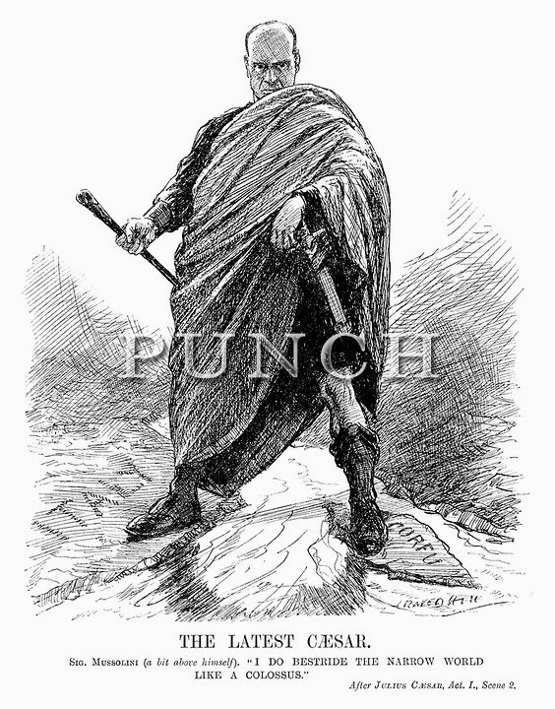
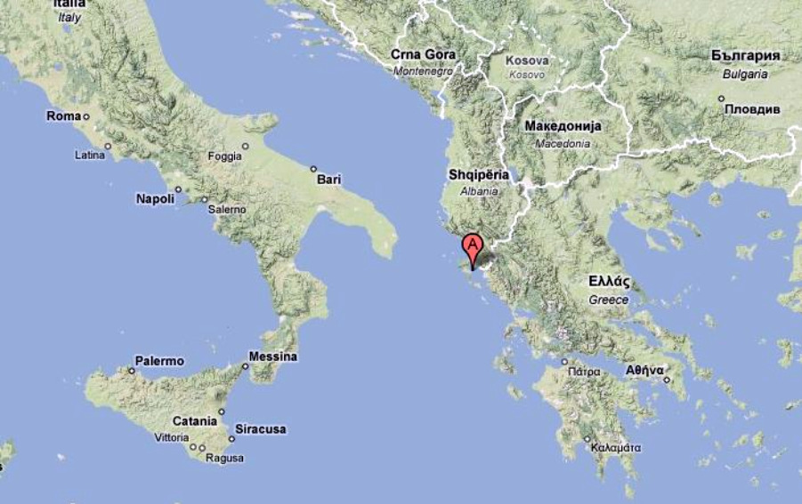
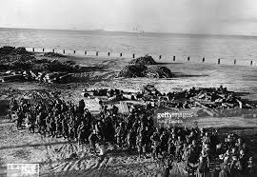
Corfu 1923 (Greece vs. Italy)
After diplomatic incidents, Italy bombed the Greek island.
Italy paid a small fine but it publicly questioned the L of N
PROBLEM
Italy was a founding member of the League and it challenged its authority
Revealed member states’ imperialistic and selfish motives

Slide 15
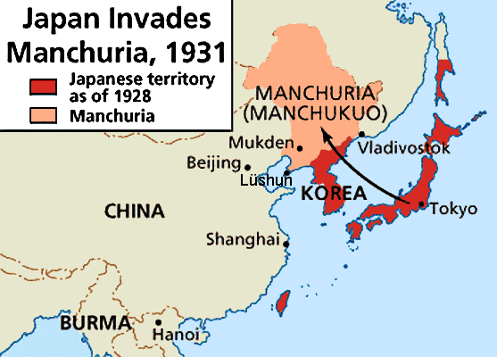
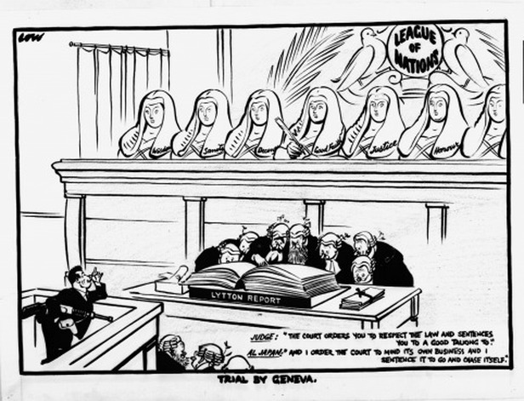
Manchurian Crisis 1931 (Japan vs. China)
Staged incident in Manchuria (Chinese region) gave Japanese army an excuse to invade and set up a ‘puppet government’
China appealed to the L of N but Japan claimed to act in self-defense.
PROBLEM
The League took over a year to issue a report (the Lytton Report) and make a decision
Meanwhile, Japan invaded more of China.
Result: Japan resigned from the L of N in March 1933
Couldn’t impose economic sanctions without the USA’s help and couldn’t use military force without members’ support.

Slide 16
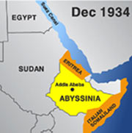
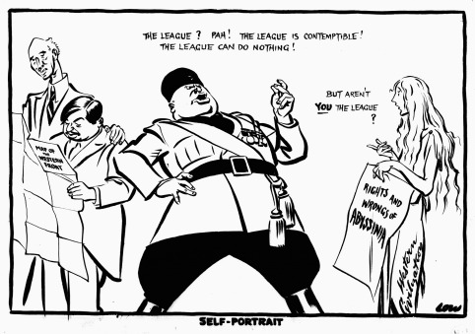
Abyssinian Crisis 1935 (Italy vs. Abyssinia)
1896: Battle of Adowa resulted in Italy’s defeat against Abyssinia
Mussolini invaded again in 1935 to gain access to fertile lands and minerals.
Tanks and Machine Guns (Italy) - vs - Cavalry and Infantry (Abyssinia) → A battle would massacre the Abyssinian people
PROBLEM
League placed economic sanctions on Italy but Mussolini continued with invasion
UK and France could have stopped invasion (by closing Suez Channel) but didn’t
Italy once again publicly defied the League’s authority

Slide 17
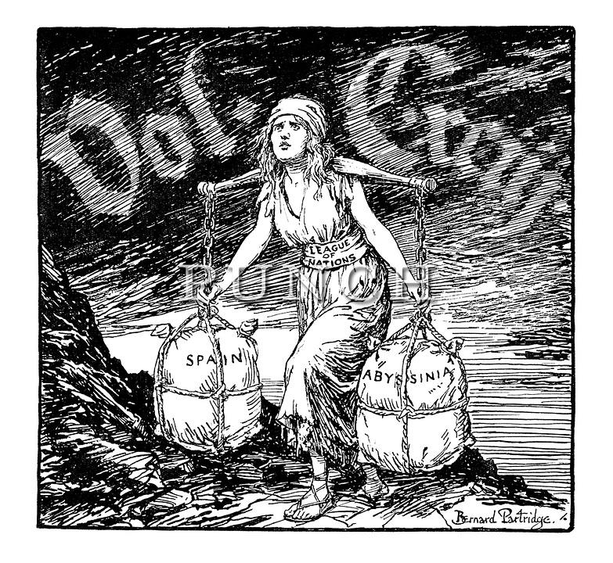
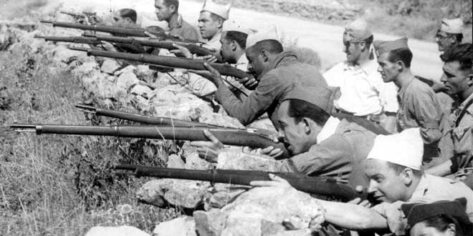
Spanish Civil War (1936-1939)
The League didn’t support the Spanish government and enabled a military conflict to become a full-on civil war.
Did not prevent death of 500,000 Spaniards
League members (e.g. Italy, UK) directly and indirectly supported Franco’s dictatorship

Slide 18
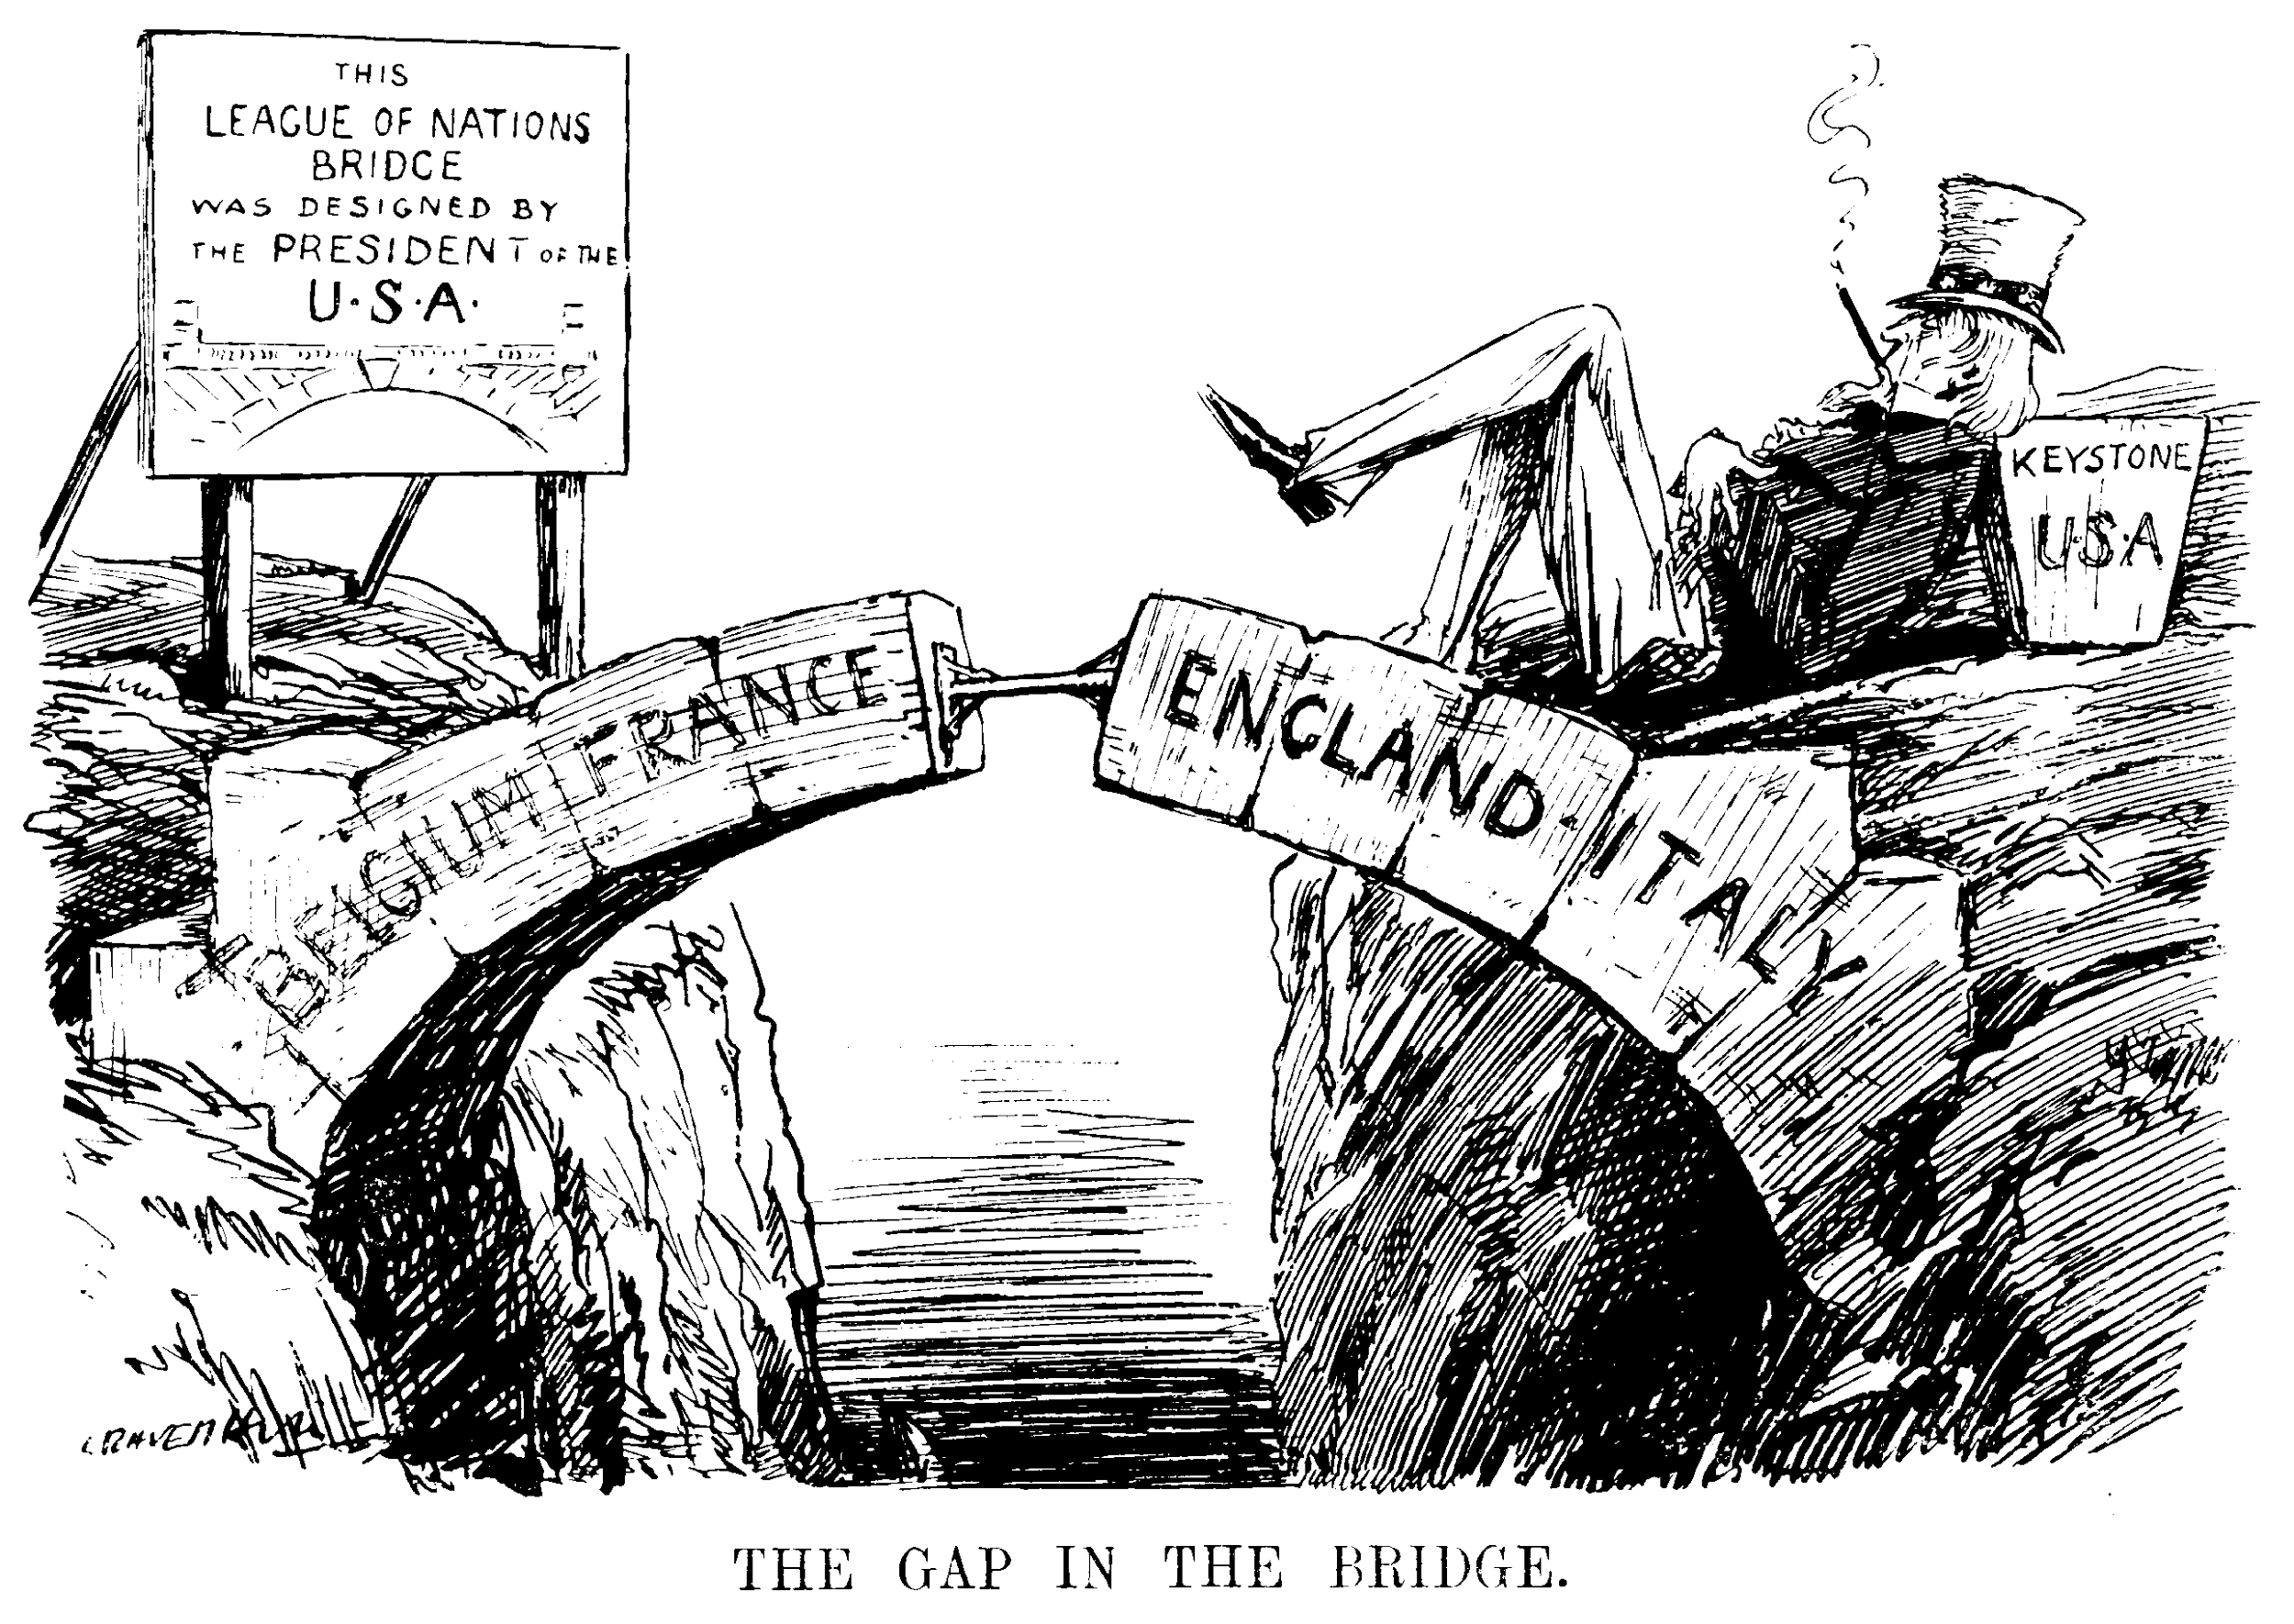
USA’ s Refusal to Join the League
o Despite being President Wilson’s initiative, Senate forbade USA’s membership due to isolationism after WWI
o League’s power was limited and authority weakened since its foundation
o League’s authority was undermined by 1922 Washington Treaty signed by 4 members (UK, France, Italy and Japan) with USA to ensure maritime strength and promote imperialistic interests

Slide 19
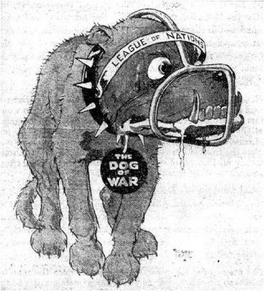
Unequal Structure
Veto Power from Permanent Council Members (UK, France, Italy and Japan)
National interests (empire and security) above world peace
Conditioned League’s success throughout its existence
The League had no independent army
The League “lacked teeth” to bite with
Depended on collective action (members’ military strength and support)

Slide 20
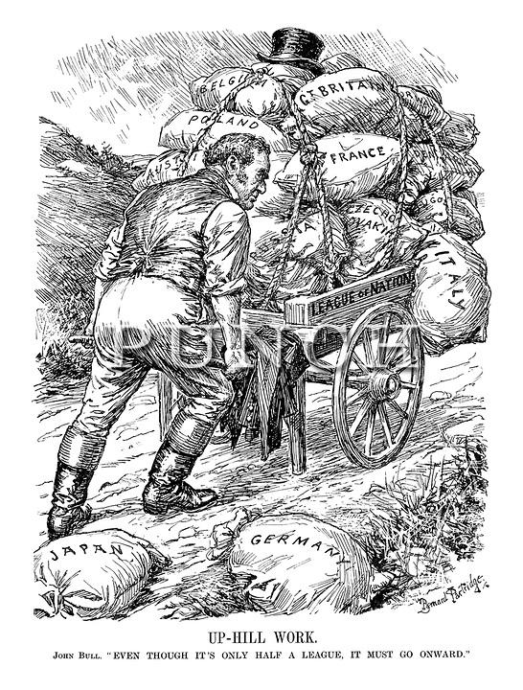
Initial Refusal to Include Germany and USSR
Germany initially not included as punishment for WWI
Accepted in 1926
Hitler withdrew in 1933 after remilitarisation of Germany
USSR initially not included due to fear of Communism - Accepted in 1934 to help against Italy’s fascism, Germany’s Nazism and Japan’s militarism - Expelled in 1939 after aggression against Finland

Slide 21
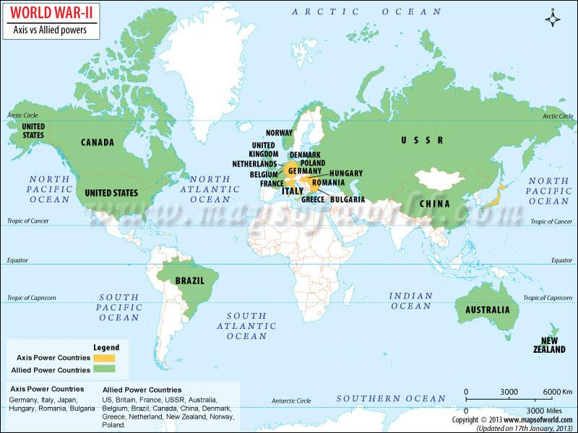
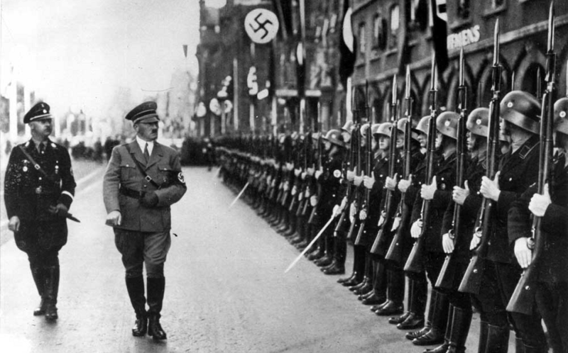
Second World War
Ultimately failed its main objective of preventing another world war
Human Toll: 60 million deaths worldwide
Lead to the dismantlement of the League of Nations in 1945

Slide 22
Conclusion
“The League of Nations has been much derided as a historical irrelevance, but it laid the foundations for an international court and established bodies that the United Nations maintains today” (Ruth Henig, 2010).
League of Nations laid the foundations for the UN
→ Serving as a blueprint for the current institution
→ Showing what mistakes to avoid
→ ILO, WHO and UNHCR

