Slide 1
6.7 The United Nations

Slide 2
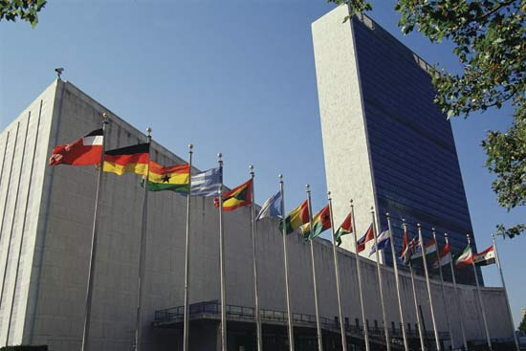
United Nations
The UN was created in response to WWII after the failure of the League of Nations.
Out of WWII came a need for a worldwide forum where nations would be able to communicate peacefully – hence, the United Nations!
Today it’s comprised of 193 nations, called “member states.”
The UN officially came into existence on October 24, 1945 at the San Francisco Conference.

Slide 3
The UN’S Purposes:
To maintain international peace and security
To develop friendly relations among nations
To cooperate in solving international problems and in promoting respect for human rights
Specific issues are carried out by the UN´s agencies like UNHCR (refugees), UNICEF (childhood) or UNESCO (cultural heritage).

Slide 4
6 Main Organs of the UN
The Secretariat
General Assembly
Security Council
The International Court of Justice
Also known as The Hague
Economic and Social Council
Trusteeship Council

Slide 5
Secretariat
The Secretariat is made up of about 43,000 people around the world and is headed by Secretary-General
Although in different countries, they answer to the UN alone & take an oath not to seek or receive instructions from any Government or outside authority.
Duty stations include the UN headquarters in New York, as well as Geneva, Vienna, Nairobi, and other locations.
The Secretariat carry out the day-to-day operations of the UN.
Ex: Keeping the peace, mediating international disputes, researching human rights, keeping media informed of UN’s activities, translate speeches/documents
This body does not vote

Slide 6
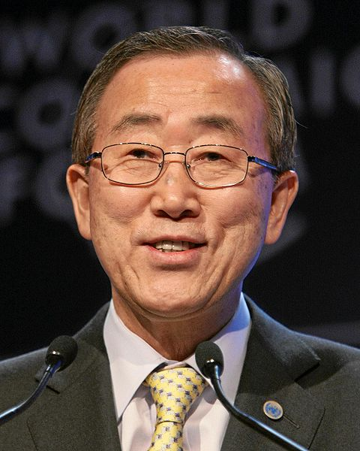
Secretary General
Secretary-Generals are elected by the General Assembly and serve 5-year terms.
The Secretary General provides overall administrative guidance to the Secretariat.
The current Secretary General is Ban Ki-moon. He is from South Korea.
Ban Ki-moon was elected the eighth Secretary-General on October 1st, 2006.
He was re-elected in 2011, and will serve until December 2016.

Slide 7
General Assembly
Also known as the “Parliament of Nations”
Each member state has one vote
Decision on key issues are decided by two-thirds majority
All other votes are decided by simple majority
Holds annual sessions from September to December
If necessary emergency sessions can be called
Has six main committees who carry out various tasks when the Assembly is not meeting
Makes decisions on many types of issues, such as international security, climate change, global trading, etc…
This is what YOU will be doing with Global Classrooms!

Slide 8
The UN’s General Assembly in session in New York

Slide 9
Security Council
Fifteen Council members—five that are permanent
China
France
Russian Federation
United Kingdom
United States
Other Council members are elected by the General Assembly for two year terms
Discusses issues of Peace and Security.
Members must be available at a moments notice in case of crisis
Simple majority vote
Decisions made are legally binding and may be enforced by sanctions (only UN organ like this!)

Slide 10
International Court of Justice
Also known as “The Hague” or “World Court”
It is the only one of UN’s 6 main organs NOT located in New York City. It is located in The Netherlands.
Is the main justice organ of the UN and settles disputes among countries, not people
This body provides legal opinions on cases and on the interpretation of International Treaties.
Participation by states in a proceeding is voluntary, but if a state agrees to participate, it is obligated to comply with the Court’s decision
15 judges are elected by the General Assembly for their judicial expertise; they do not represent their countries.

Slide 11
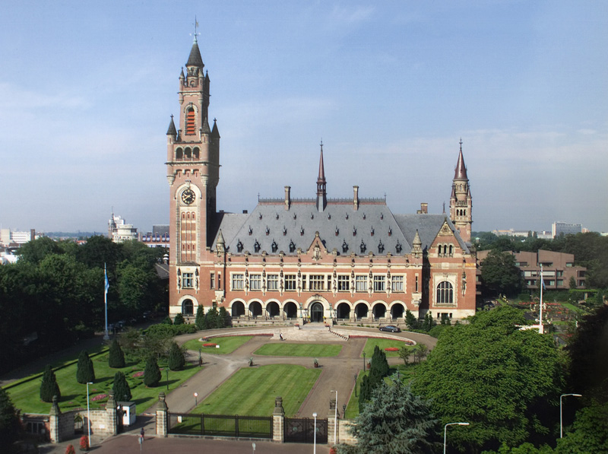
Peace Palace in The Hague, Netherlands

Slide 12
Economic and Social Council
Coordinates the economic and social work of the United Nations and the UN family of organizations
Plays key role in fostering international cooperation for development
Has 54 members, elected by General Assembly for three-year terms
This Body regularly works with Non- Governmental Organizations (NGOs).

Slide 13
Trusteeship Council
Was established after WWII to provide international supervision for 11 Trust Territories to ensure that adequate steps were taken to prepare the Territories for self-government or independence
The Trusteeship Council no longer meets. It was suspended on Nov. 1, 1994 when Palau, the last trust territory, became independent.
It can meet when requested to by the majority of its members or when requested by the General Assembly or the Security Council.
Made up of the same 5 permanent members as those of the Security Council

Slide 14
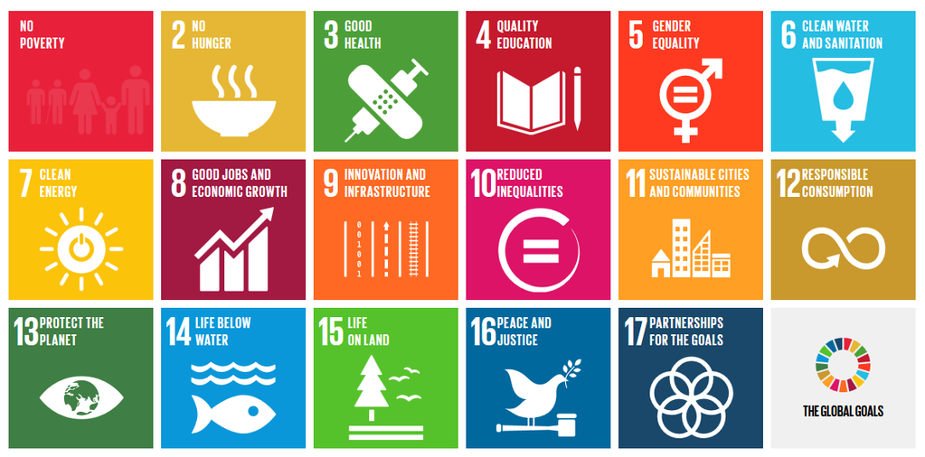
UN’s Sustainable Development Goals for 2030

